Slide 1
Message Authentication & MAC
In the context of communication across the network, following attacks can be identified.
Disclosure
Traffic Analysis
Masquerade
Content Modification
Sequence Modification
Timing Modification
Source Repudiation
Destination Repudiation

Slide 2
Authentication Requirements
Measures to deal 1 & 2 attacks comes under message privacy.
Measures to deal with 3 to 6 comes under message authentication.
Measures to deal with 7 comes under digital signature. However, may also be used to address attacks from 3 to 6.
Measures to deal with 8 requires digital signature along with few other protocols.

Slide 3
Authentication Functions
Any message authentication is fundamentally having two levels.
At the lower level, some authenticator is generated & at the next level, generated authenticator is used to authenticate the message.
Three types of functions that may be used to produce the authenticator.
Message encryption: Ciphertext of the entire message serves as authenticator.
Message authentication Code (MAC) : Function of the message and a secret key that produces a fixed length value that serves as authenticator.
Hash function: Function that maps a message to fixed length value that serves as authenticator.

Slide 4
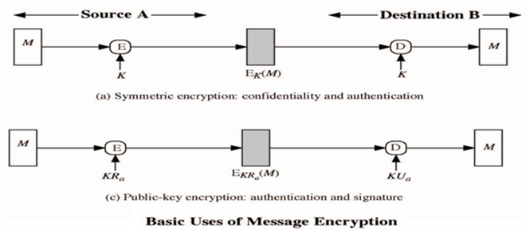
Message Encryption

Slide 5
Message Authentication Code (MAC)
Here MAC function C creates a small fixed-sized block depending on both message M and a shared secret key K.
  MAC is appended to the message M
    MAC=C_{K}(M)
    M: Message
    K: Secret key
    C: MAC function
    MAC: Message authentication code

Slide 6
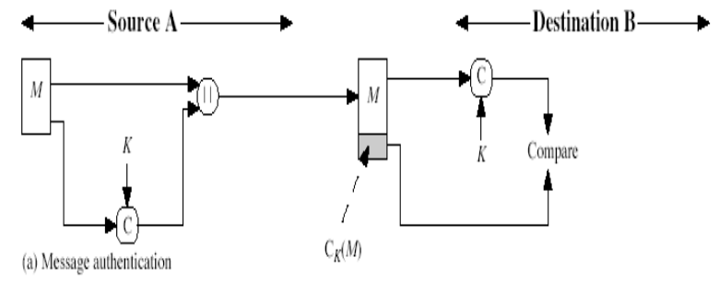
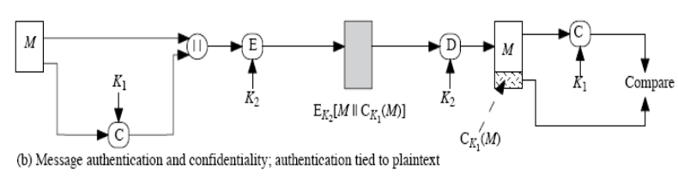
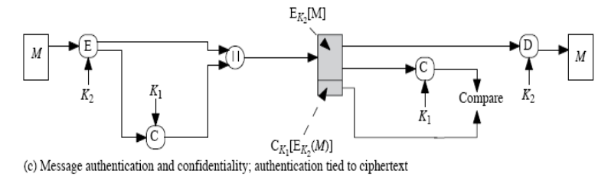
Message Authentication Code (MAC)

Slide 7
MAC function Analysis
Cryptanalysis can be done as follows:
Suppose k>n where k is the key size and n is the MAC size.
Given a known M₁ and MAC₁ with MAC₁=C_{K1}(M₁).
The cryptanalysis can perform MAC_{i}=C_{Ki}(M₁) for all possible key values.
At least one key is guaranteed to produce a match of MAC_{i}=MAC_{1.}
As there are total of 2^{n} MAC with 2^{n}<2^{k} keys i.e. a number of keys will produce the correct MAC.
On an average, 2^{k}/2^{n}=2^{k-n} keys will produce a match.

Slide 8
Requirements of MAC function
The MAC function must satisfy the following requirements:
If an opponent observes M & C_{k}(M), it is computationally infeasible for the opponent to construct the message M’ such that C_{k}(M’)=C_{k}(M).
C_{k}(M) should be uniformly distributed such that with randomly chosen messages M and M’, the probability C_{k}(M)=C_{k}(M’) is 2^{-n} where n is the number of bits in the MAC.

Slide 9
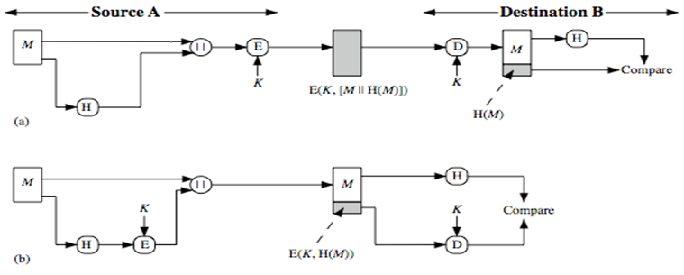
Hash Functions
A variation of the MAC is a one way hash function.
Here hash function accepts a variable size message M as input and produces a fixed size output, referred to as H(M).
(a) Encrypt message plus hash code.
(b) Encrypt hash code - shared secret key

Slide 10
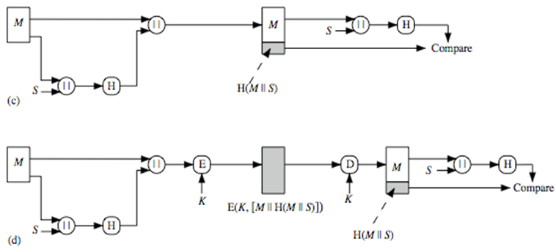
Hash Functions
(c) Compute hash code of message plus secret value.
(d) Encrypt result of (c).

Slide 11
Requirements of Hash function
H can be applied to block of data of any size.
H produces fixed-length output.
H(x) is relatively easy to compute for any given x.
For any given h, it is computationally infeasible to find x such that H(x)=h. This is referred to as one-way property.
For any given block x, it is computationally infeasible to find y≠x with H(y)=H(x). This is referred to as weak collision resistance.
It is computationally infeasible to find pair (x,y) such that H(x)=H(y). This is referred to as strong collision resistance.

Slide 12
Security of Hash Function & MACs
We can group attacks on hash function and MAC’s into two categories: brute force attacks and cryptanalysis.
Brute force attack:
Hash functions:
For any given h, it is computationally infeasible to find x such that H(x)=h. This is referred to as one-way property.
For any given block x, it is computationally infeasible to find y≠x with H(y)=H(x). This is referred to as weak collision resistance.
It is computationally infeasible to find pair (x,y) such that H(x)=H(y). This is referred to as strong collision resistance.

Slide 13
Security of Hash Function & MACs
For a code of length n, the level of effort required is proportional to the following:
    One way: 2^{n}
    Weak collision resistance: 2^{n}
    Strong Collision resistance: 2^{n/2}

Slide 14
Security of Hash Function & MACs
Brute force attack:
MAC:
Given a fixed message x with n-bit MAC code h=H(x), a brute force method of finding a collision is to pick a random bit string and check if H(y)=H(x).
There are two lines of attacks possible: Attack the key space and attack the MAC values.
Attack on Key space:
Suppose the key size is k bits and that the attacker has one known text MAC pair. Then the attacker can compute the n-bit MAC on the known text for all possible keys.
At least, one key is guaranteed to produce the correct match.
This phase of attack takes a level of effort proportional to 2^{k}

Slide 15
Security of Hash Function & MACs
Attack on MAC space:
The objective is to generate a valid MAC value for a given message or to find a message that matches a given MAC value.
The level of effort is comparable to that for attacking the one way or weak collision resistance property of a hash function (2^{n}).
Finally the level of effort for brute force attack on a MAC algorithm can be expressed as min(2^{k},2^{n} ).

Slide 16
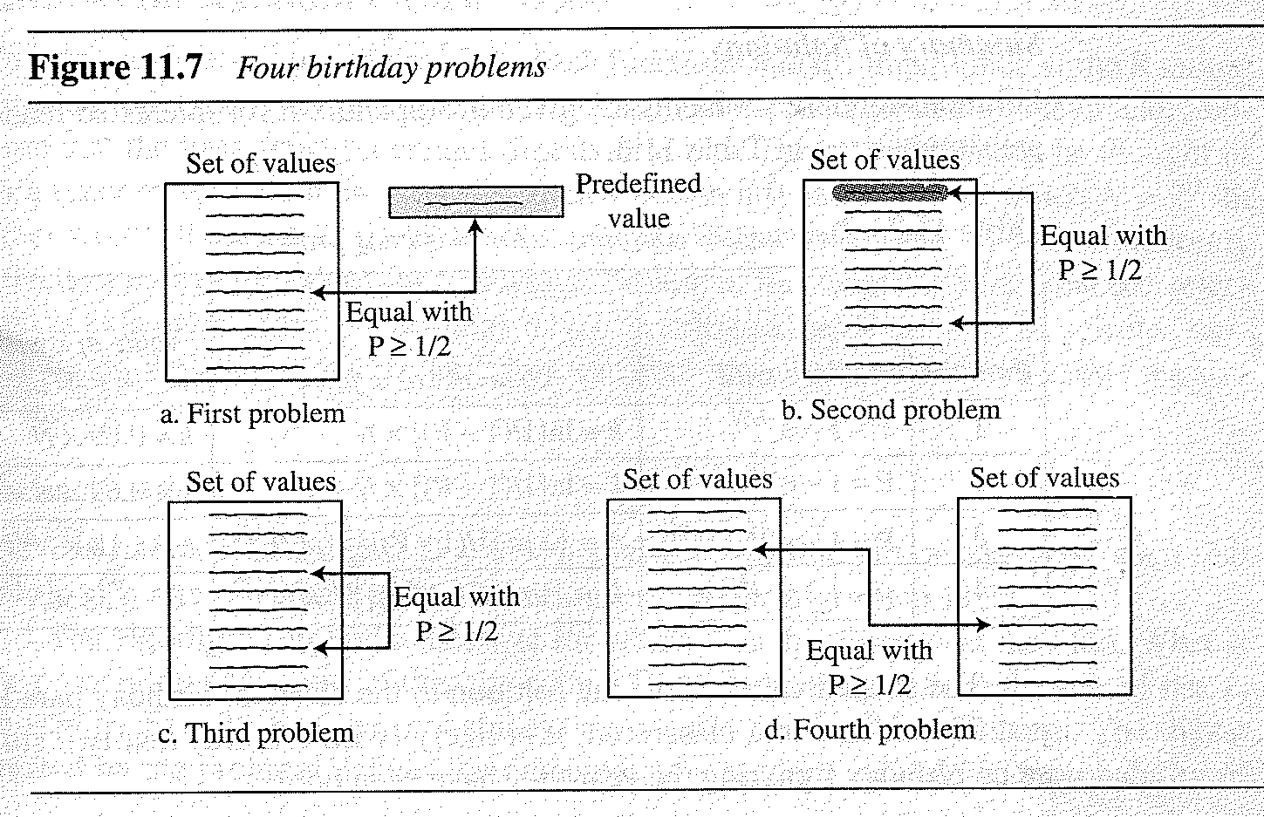
Birthday Problems
The four different birthday problems usually there in probability.
The third problem is refereed to as Birthday paradox.

Slide 17
Birthday Problems
Problem 1: What is the minimum number, k, of students in classroom such that it is likely that at least one student has a predefined birthday.
We have a uniformly distributed random variable with N possible values, then what is the minimum number of instances k such that it is likely that at least one instance is equal to a predefined value.
Problem 2: What is the minimum number, k, of students in classroom such that it is likely that at least one student has the same birthday as the student selected by the professor.
We have a uniformly distributed random variable with N possible values, then what is the minimum number of instances k such that it is likely that at least one instance is equal to the selected one.

Slide 18
Birthday Problems
Problem 3: What is the minimum number, k, of students in classroom such that it is likely that at least two students have the same birthday.
We have a uniformly distributed random variable with N possible values, then what is the minimum number of instances k such that it is likely that at least two instances are equal.
Problem 4: We have two classes, each with k students. What is the minimum value k so that it is likely that at least one student from the first classroom has the same birthday as a student from the second classroom
We have a uniformly distributed random variable with N possible values. We generate two sets of random values each with k instances. What is the minimum number k such that it is likely that at least one instance from the first set is equal to one instance on the second set.

Slide 19
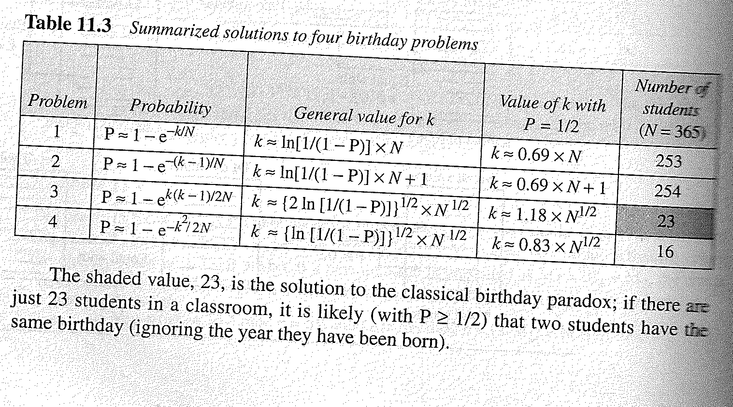
Birthday Problems
23 is the solution to the classical Birthday paradox problem. If there are just 23 students in a classroom, it is likely that (with P >1/2) that the two students have the same birthday (ignoring the year of birth).

Slide 20

SHA Versions
Notes:
Stallings Table 11.3 provides a comparison of the various parameters for the SHA hash functions.

Slide 21
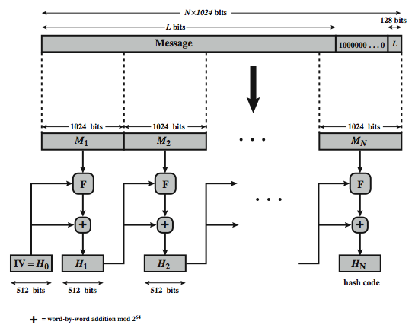
SHA-512 Overview
Notes:
Now examine the structure of SHA-512, noting that the other versions are quite similar.
SHA-512 follows the structure depicted in Stallings Figure 11.8. The processing consists of the following steps:
• Step 1: Append padding bits, consists of a single 1-bit followed by the necessary number of 0-bits, so that its length is congruent to 896 modulo 1024
• Step 2: Append length as an (big-endian) unsigned 128-bit integer
• Step 3: Initialize hash buffer to a set of 64-bit integer constants (see text)
• Step 4: Process the message in 1024-bit (128-word) blocks, which forms the heart of the algorithm. Each round takes as input the 512-bit buffer value H_{i}, and updates the contents of that buffer.
• Step 5: Output the final state value as the resulting hash
See text for more details.

Slide 22
SHA-512 Logic
1. Append padding bits : The message is padded, so that padded message is 128 bits less than an integer multiple of 1024.
2. Append length: A 128 bits of message length is appended to the message. (M mod 2^128)
3. Initialize hash buffer: A 512 bit buffer is used to hold intermediate and final results.
a=6A09E667F3BCC908, b=, c=, d=, e=,f=,g=, h=
These values are stored in big-endian format.
Notes:
The SHA-512 Compression Function is the heart of the algorithm. In this Step 4, it processes the message in 1024-bit (128-word) blocks, using a module that consists of 80 rounds, labeled F in Stallings Figure 11.8, and is shown in detail in Figure 11.9. Each round takes as input the 512-bit buffer value, and updates the contents of the buffer. At input to the first round, the buffer has the value of the intermediate hash value. Each round t makes use of a 64-bit value Wt derived using a message schedule from the current 1024-bit block being processed. Each round also makes use of an additive constant Kt, based on the fractional parts of the cube roots of the first eighty prime numbers. The constants provide a “randomized” set of 64-bit patterns, which should eliminate any regularities in the input data. The output of the eightieth round is added to the input to the first round to produce the final hash value for this message block, which forms the input to the next iteration of this compression function, as shown on the previous slide.

Slide 23
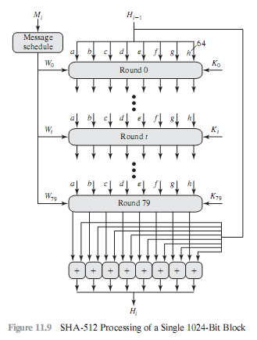
4. Processing in multiple of 1024-bit blocks: This module is the heart of the algorithm and consists of 80 rounds.

Slide 24
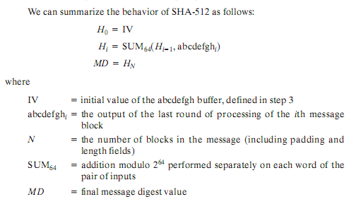
4. SHA Processing
5. Output: After all N 1024 bit blocks have been processed, the output from the Nth stage is the 512 bit digest.
Notes:
The SHA-512 Compression Function is the heart of the algorithm. In this Step 4, it processes the message in 1024-bit (128-word) blocks, using a module that consists of 80 rounds, labeled F in Stallings Figure 11.8, and is shown in detail in Figure 11.9. Each round takes as input the 512-bit buffer value, and updates the contents of the buffer. At input to the first round, the buffer has the value of the intermediate hash value. Each round t makes use of a 64-bit value Wt derived using a message schedule from the current 1024-bit block being processed. Each round also makes use of an additive constant Kt, based on the fractional parts of the cube roots of the first eighty prime numbers. The constants provide a “randomized” set of 64-bit patterns, which should eliminate any regularities in the input data. The output of the eightieth round is added to the input to the first round to produce the final hash value for this message block, which forms the input to the next iteration of this compression function, as shown on the previous slide.

Slide 25
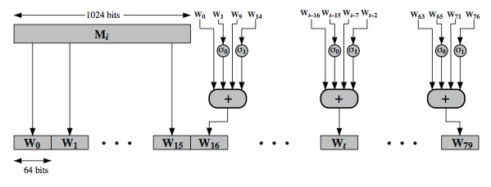
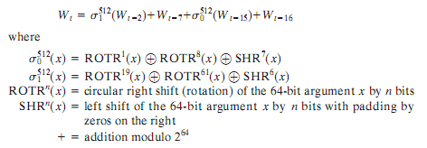
SHA-512 Round Function Wn
Notes:
Stallings Figure 11.11 illustrates how the 64-bit word values Wt are derived from the 1024-bit message. The first 16 values of Wt are taken directly from the 16 words of the current block. The remaining values are defined as a function of the earlier values using ROTates, SHIFTs and XORs as shown. The function elements are:
∂0(x) = ROTR(x,1) XOR ROTR(x,8) XOR SHR(x,7)
∂1(x) = ROTR(x,19) XOR ROTR(x,61) XOR SHR(x,6)
Thus, in the first 16 steps of processing, the value of W_{t} is equal to the corresponding word in the message block. For the remaining 64 steps, the value of W_{t} consists of the circular left shift by one bit of the XOR of four of the preceding values of W_{t}, with two of those values subjected to shift and rotate operations. This introduces a great deal of redundancy and interdependence into the message blocks that are compressed, which complicates the task of finding a different message block that maps to the same compression function output.
See text for details of an example based on one in FIPS 180.

Slide 26
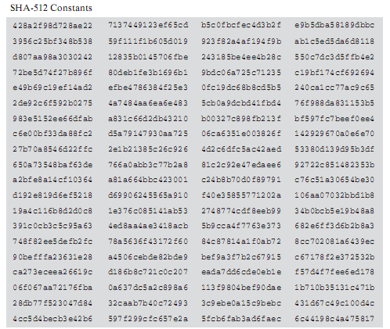
SHA-512 Round Function Kt
Each round makes use of additive constant Kt where each Kt represents fractional parts of the cube roots the first 80 prime numbers.
Notes:
Stallings Figure 11.11 illustrates how the 64-bit word values Wt are derived from the 1024-bit message. The first 16 values of Wt are taken directly from the 16 words of the current block. The remaining values are defined as a function of the earlier values using ROTates, SHIFTs and XORs as shown. The function elements are:
∂0(x) = ROTR(x,1) XOR ROTR(x,8) XOR SHR(x,7)
∂1(x) = ROTR(x,19) XOR ROTR(x,61) XOR SHR(x,6)
Thus, in the first 16 steps of processing, the value of W_{t} is equal to the corresponding word in the message block. For the remaining 64 steps, the value of W_{t} consists of the circular left shift by one bit of the XOR of four of the preceding values of W_{t}, with two of those values subjected to shift and rotate operations. This introduces a great deal of redundancy and interdependence into the message blocks that are compressed, which complicates the task of finding a different message block that maps to the same compression function output.
See text for details of an example based on one in FIPS 180.

Slide 27
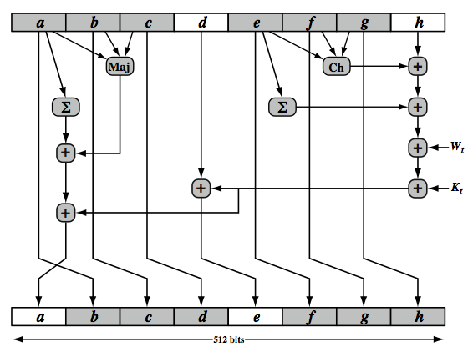
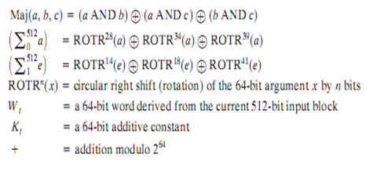
SHA-512 Round Function
Notes:
The structure of each of the 80 rounds is shown in Stallings Figure 11.10. Each 64-bit word is shuffled along one place, and in some cases manipulated using a series of simple logical functions (ANDs, NOTs, ORs, XORs, ROTates), in order to provide the avalanche & completeness properties of the hash function. The elements are:
Ch(e,f,g) = (e AND f) XOR (NOT e AND g)
Maj(a,b,c) = (a AND b) XOR (a AND c) XOR (b AND c)
∑(a) = ROTR(a,28) XOR ROTR(a,34) XOR ROTR(a,39)
∑(e) = ROTR(e,14) XOR ROTR(e,18) XOR ROTR(e,41)
+ = addition modulo 2^64
Kt = a 64-bit additive constant
Wt = a 64-bit word derived from the current 512-bit input block.
Six of the eight words of the output of the round function involve simply permutation (b, c, d, f, g, h) by means of rotation. This is indicated by shading in Figure 11.10. Only two of the output words (a, e) are generated by substitution. Word e is a function of input variables d, e, f, g, h, as well as the round word W t and the constant Kt. Word a is a function of all of the input variables, as well as the round word W t and the constant Kt.

Slide 28
Digital Signature
13.<number>

Slide 29
13-1 COMPARISON
Let us begin by looking at the differences between conventional signatures and digital signatures.
Topics to be discussed :
13.1.1 Inclusion
13.1.2 Verification Method
13.1.3 Relationship
13.1.4 Duplicity
13.<number>

Slide 30
13.1.1 Inclusion
A conventional signature is included in the document; it is part of the document.
But when we sign a document digitally, we send the signature as a separate document.
13.<number>

Slide 31
13.1.2 Verification Method
For a conventional signature, when the recipient receives a document, she compares the signature on the document with the signature on file.
For a digital signature, the recipient receives the message and the signature. The recipient needs to apply a verification technique to the combination of the message and the signature to verify the authenticity.
13.<number>

Slide 32
13.1.3 Relationship
For a conventional signature, there is normally a one-to-many relationship between a signature and documents.
For a digital signature, there is a one-to-one relationship between a signature and a message.
13.<number>

Slide 33
13.1.4 Duplicity
In conventional signature, a copy of the signed document can be distinguished from the original one on file.
In digital signature, there is no such distinction unless there is a factor of time on the document.
13.<number>

Slide 34
13-2 PROCESS
Figure shows the digital signature process.
The sender uses a signing algorithm to sign the message.
The message and the signature are sent to the receiver.
The receiver receives the message and the signature and applies the verifying algorithm to the combination.
If the result is true, the message is accepted; otherwise, it is rejected.
13.<number>

Slide 35
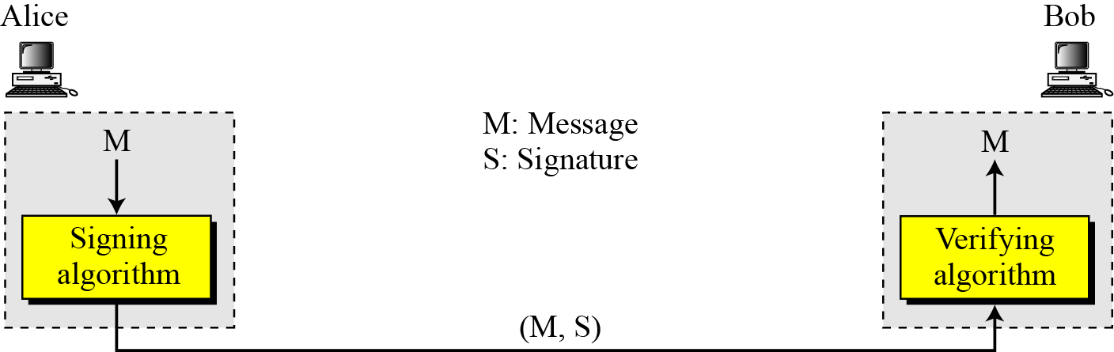
13-2 Continued
Digital signature process
13.<number>

Slide 36
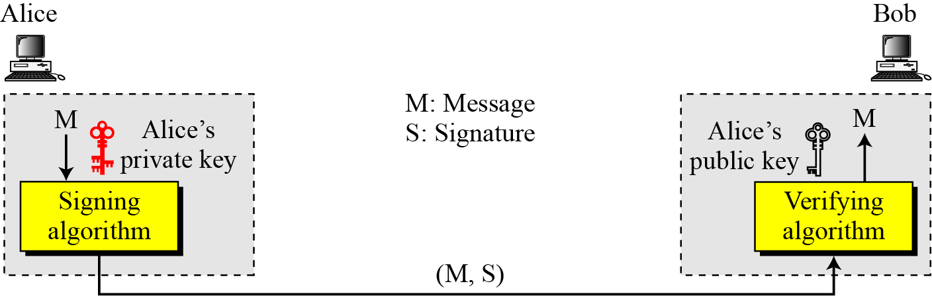

13.2.1 Need for Keys
Adding key to the digital signature process
Note
A digital signature needs a public-key system.
The signer signs with her private key; the verifier verifies with the signer’s public key.
13.<number>

Slide 37
13.2.1 Continued
Note
A cryptosystem uses the private and public keys of the receiver: a digital signature uses
the private and public keys of the sender.
13.<number>

Slide 38
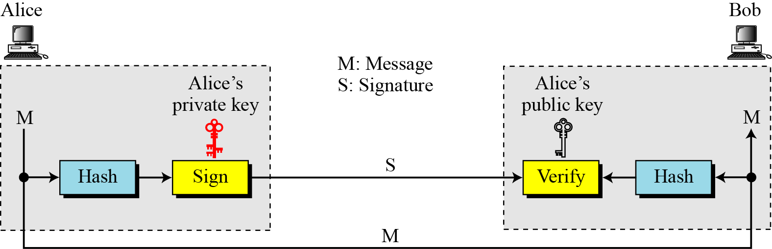
13.2.2 Signing the Digest
Signing the digest
13.<number>

Slide 39
13-3 SERVICES
We discussed several security services earlier including message confidentiality, message authentication, message integrity, and nonrepudiation.
A digital signature can directly provide the last three; for message confidentiality we still need encryption/decryption.
13.<number>

Slide 40
13.3.1 Message Authentication
A secure digital signature scheme, like a secure conventional signature can provide message authentication. Bob can verify that the message is sent by Alice because Alice’s public key is used in verification.
Note
A digital signature provides message authentication.
13.<number>

Slide 41
13.3.2 Message Integrity
The integrity of the message is preserved even if we sign the whole message because we cannot get the same signature if the message is changed.
Note
A digital signature provides message integrity.
13.<number>

Slide 42
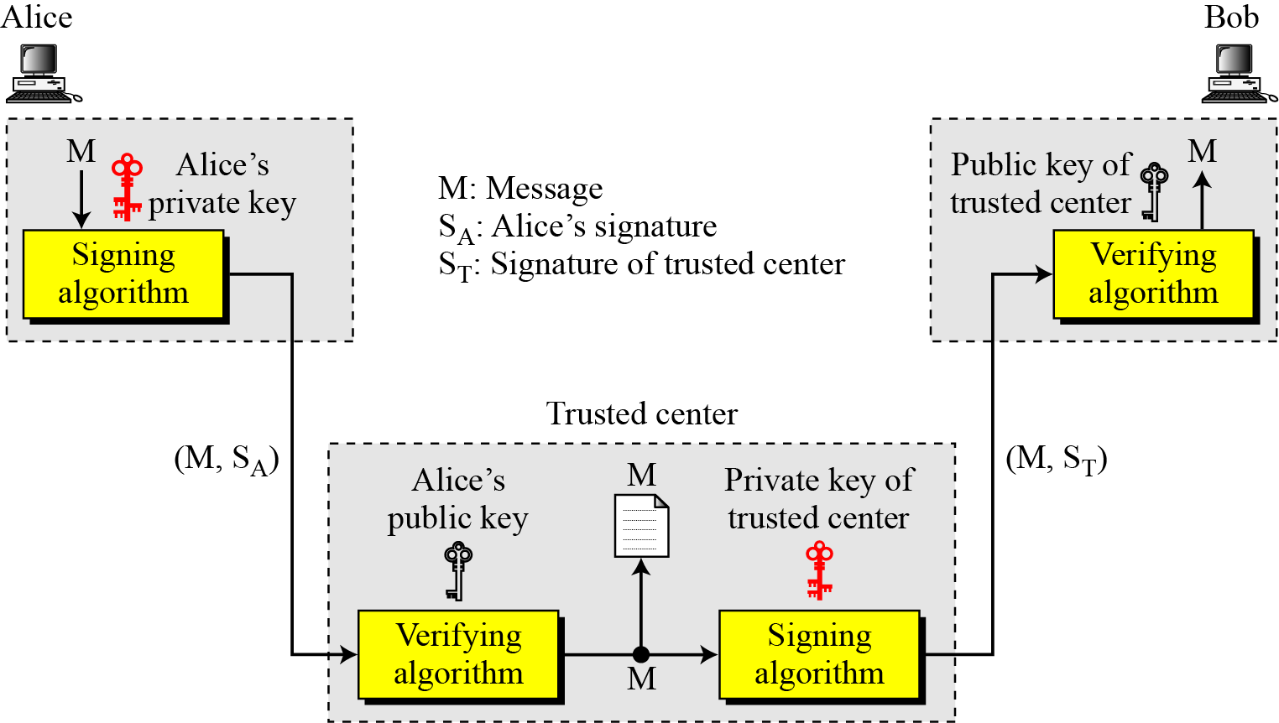
13.3.3 Nonrepudiation
Figure 13.4 Using a trusted center for nonrepudiation
Note
Nonrepudiation can be provided using a trusted party.
13.<number>

Slide 43
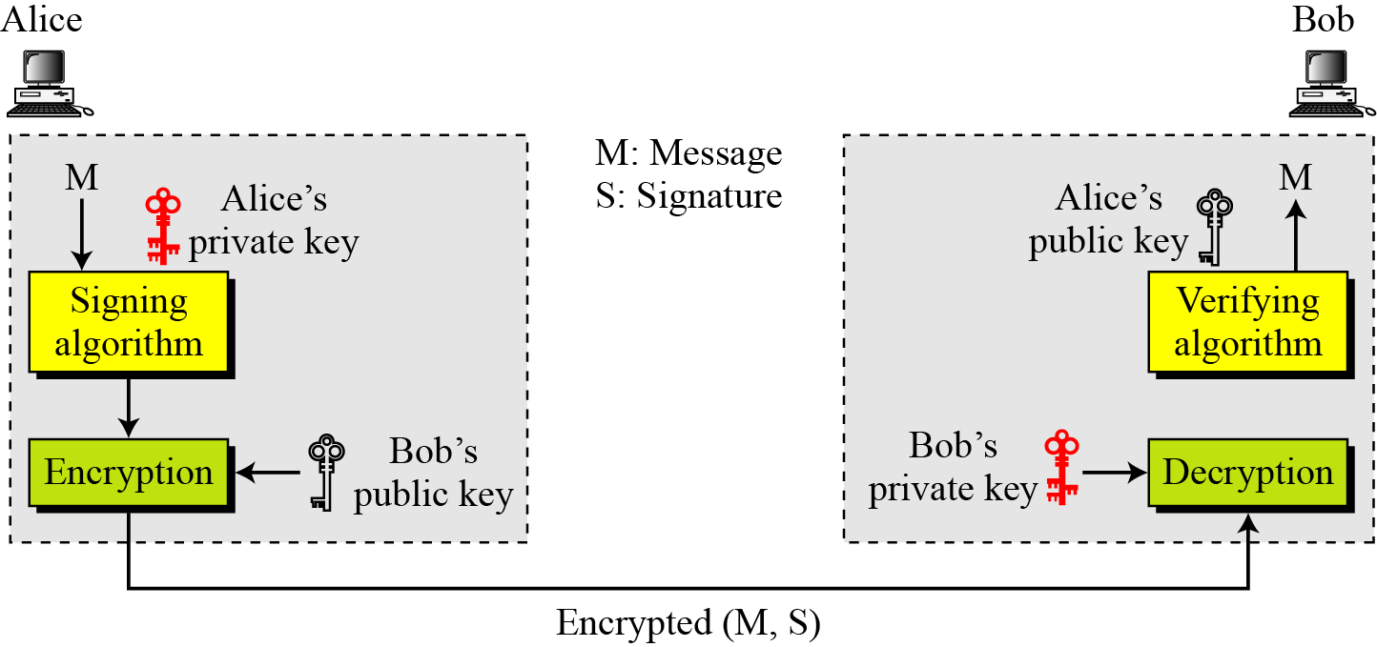
13.3.4 Confidentiality
Figure 13.5 Adding confidentiality to a digital signature scheme
Note
A digital signature does not provide privacy.
If there is a need for privacy, another layer of encryption/decryption must be applied.
13.<number>

Slide 44
DIGITAL SIGNATURE SCHEMES
Several digital signature schemes have evolved during the last few decades. Some of them have been implemented.
RSA Digital Signature Scheme
ElGamal Digital Signature Scheme
Digital Signature Standard (DSS)
13.<number>

Slide 45
13.5.1 Continued
Key Generation
Key generation in the RSA digital signature scheme is exactly the same as key generation in the RSA
Note
In the RSA digital signature scheme, d is private;
e and n are public.
13.<number>

Slide 46
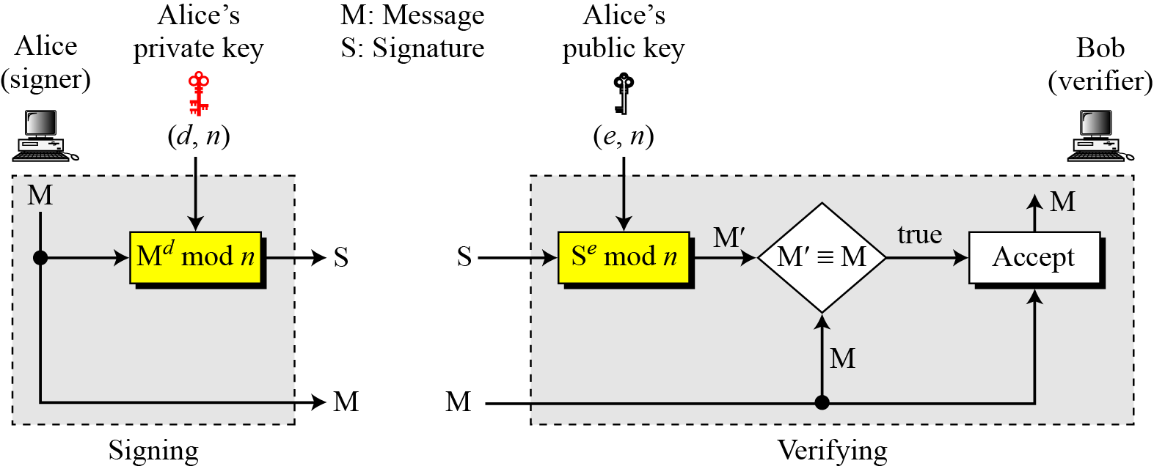
13.5.1 Continued
Signing and Verifying
Figure 13.7 RSA digital signature scheme
13.<number>

Slide 47
13.5.1 Continued
Example 13.1
As a trivial example, suppose that Alice chooses p = 823 and q = 953, and calculates n = 784319. The value of φ(n) is 782544. Now she chooses e = 313 and calculates d = 160009. At this point key generation is complete. Now imagine that Alice wants to send a message with the value of M = 19070 to Bob. She uses her private exponent, 160009, to sign the message:
Alice sends the message and the signature to Bob. Bob receives the message and the signature. He calculates
Bob accepts the message because he has verified Alice’s signature.
13.<number>

Slide 48
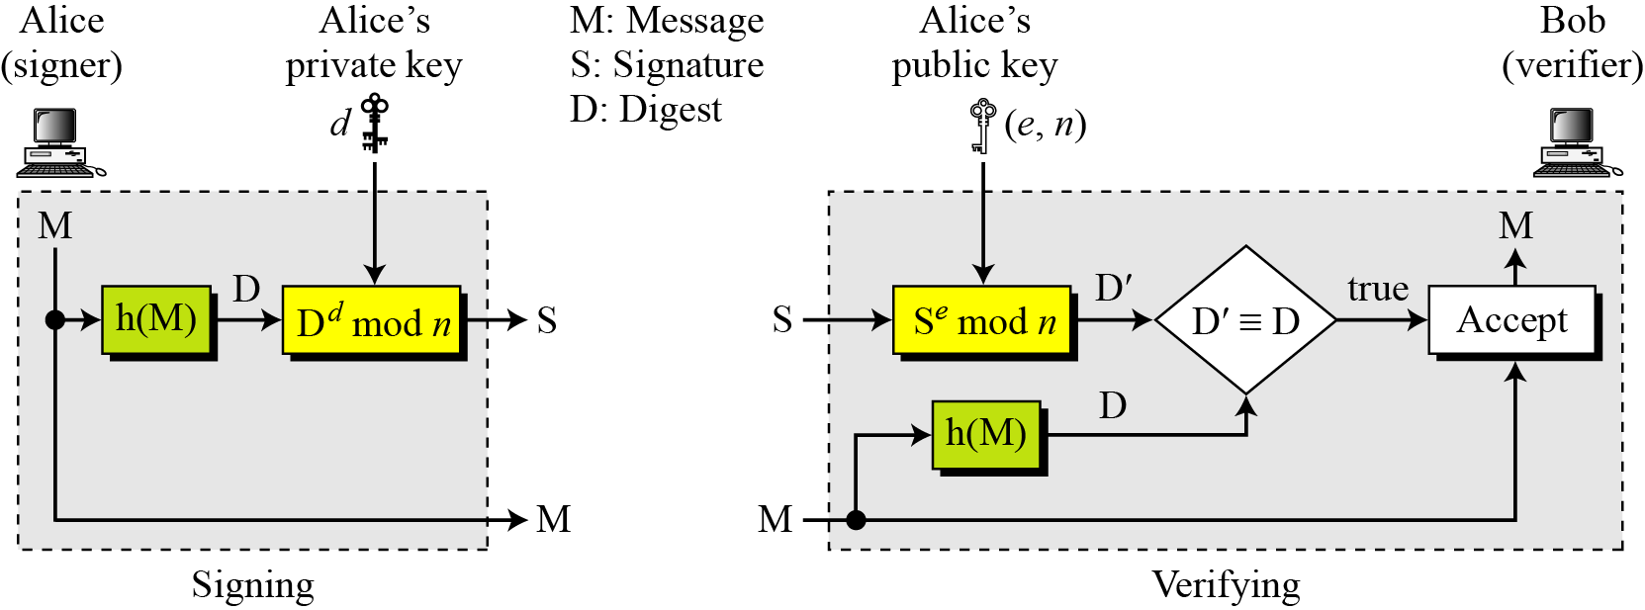
13.5.1 Continued
RSA Signature on the Message Digest
Figure 13.8 The RSA signature on the message digest
13.<number>

Slide 49
13.5.1 Continued
Note
When the digest is signed instead of the message itself, the susceptibility of the RSA digital signature scheme depends on the strength of the hash algorithm.
13.<number>

Slide 50
13.5.2 Continued
ElGamal digital signature scheme
Key Generation
The key generation procedure here is exactly the same as the one used in the cryptosystem.
Note
In ElGamal digital signature scheme, (e₁, e₂, p) is Alice’s public key; d is her private key.
13.<number>

Slide 51
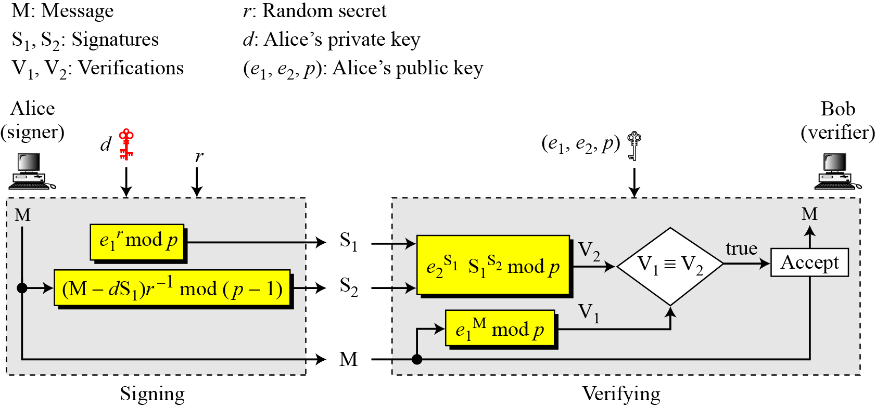
13.5.2 Continued
Verifying and Signing
Figure 13.10 ElGamal digital signature scheme
13.<number>

Slide 52
Digital Signature Standard (DSS)
US Govt approved signature scheme
designed by NIST & NSA in early 90's
published as FIPS-186 in 1991
revised in 1993, 1996 & then 2000
uses the SHA hash algorithm
DSS is the standard, DSA is the algorithm
FIPS 186-2 (2000) includes alternative RSA & elliptic curve signature variants
DSA is digital signature only unlike RSA is a public-key technique
Notes:
DSA is the US Govt approved signature scheme, which is designed to provide strong signatures without allowing easy use for encryption. The National Institute of Standards and Technology (NIST) published Federal Information Processing Standard FIPS 186, known as the Digital Signature Standard (DSS). The DSS makes use of the Secure Hash Algorithm (SHA) described in Chapter 12 and presents a new digital signature technique, the Digital Signature Algorithm (DSA). The DSS was originally proposed in 1991 and revised in 1993 in response to public feedback concerning the security of the scheme. There was a further minor revision in 1996. In 2000, an expanded version of the standard was issued as FIPS 186-2. This latest version also incorporates digital signature algorithms based on RSA and on elliptic curve cryptography. In this section, we discuss the original DSS algorithm. The DSS uses an algorithm that is designed to provide only the digital signature function. Unlike RSA, it cannot be used for encryption or key exchange. Nevertheless, it is a public-key technique.

Slide 53
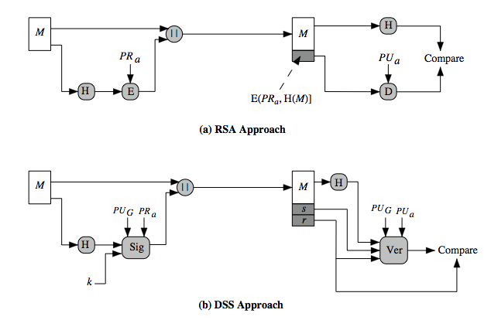
DSS vs RSA Signatures
Notes:
Stallings Figure 13.3 contrasts the DSS approach for generating digital signatures to that used with RSA. In the RSA approach, the message to be signed is input to a hash function that produces a secure hash code of fixed length. This hash code is then encrypted using the sender's private key to form the signature. Both the message and the signature are then transmitted. The recipient takes the message and produces a hash code. The recipient also decrypts the signature using the sender's public key. If the calculated hash code matches the decrypted signature, the signature is accepted as valid. Because only the sender knows the private key, only the sender could have produced a valid signature. The DSS approach also makes use of a hash function. The hash code is provided as input to a signature function along with a random number k generated for this particular signature. The signature function also depends on the sender's private key (PR _{a}) and a set of parameters known to a group of communicating principals. We can consider this set to constitute a global public key (PU_{G}). The result is a signature consisting of two components, labeled s and r. At the receiving end, the hash code of the incoming message is generated. This plus the signature is input to a verification function. The verification function also depends on the global public key as well as the sender's public key (PU_{a}), which is paired with the sender's private key. The output of the verification function is a value that is equal to the signature component r if the signature is valid. The signature function is such that only the sender, with knowledge of the private key, could have produced the valid signature.

Slide 54
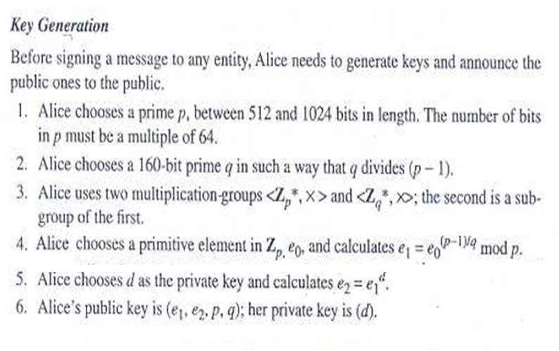
Digital Signature Standard (DSS)
Notes:
DSA is the US Govt approved signature scheme, which is designed to provide strong signatures without allowing easy use for encryption. The National Institute of Standards and Technology (NIST) published Federal Information Processing Standard FIPS 186, known as the Digital Signature Standard (DSS). The DSS makes use of the Secure Hash Algorithm (SHA) described in Chapter 12 and presents a new digital signature technique, the Digital Signature Algorithm (DSA). The DSS was originally proposed in 1991 and revised in 1993 in response to public feedback concerning the security of the scheme. There was a further minor revision in 1996. In 2000, an expanded version of the standard was issued as FIPS 186-2. This latest version also incorporates digital signature algorithms based on RSA and on elliptic curve cryptography. In this section, we discuss the original DSS algorithm. The DSS uses an algorithm that is designed to provide only the digital signature function. Unlike RSA, it cannot be used for encryption or key exchange. Nevertheless, it is a public-key technique.

Slide 55
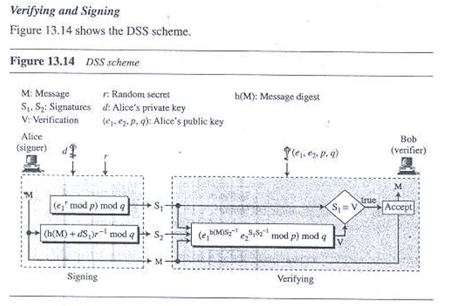
Digital Signature Standard (DSS)
13.<number>

Slide 56
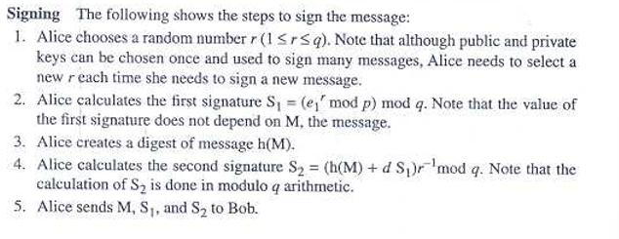
Digital Signature Standard (DSS)
13.<number>

Slide 57
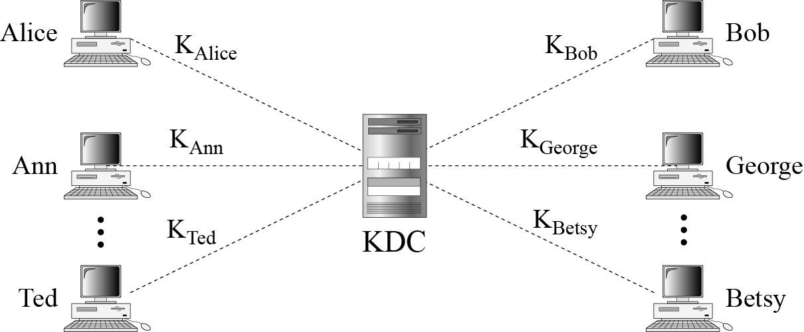
15.1.1 Key-Distribution Center: KDC
Figure 15.1 Key-distribution center (KDC)
15.<number>

Slide 58
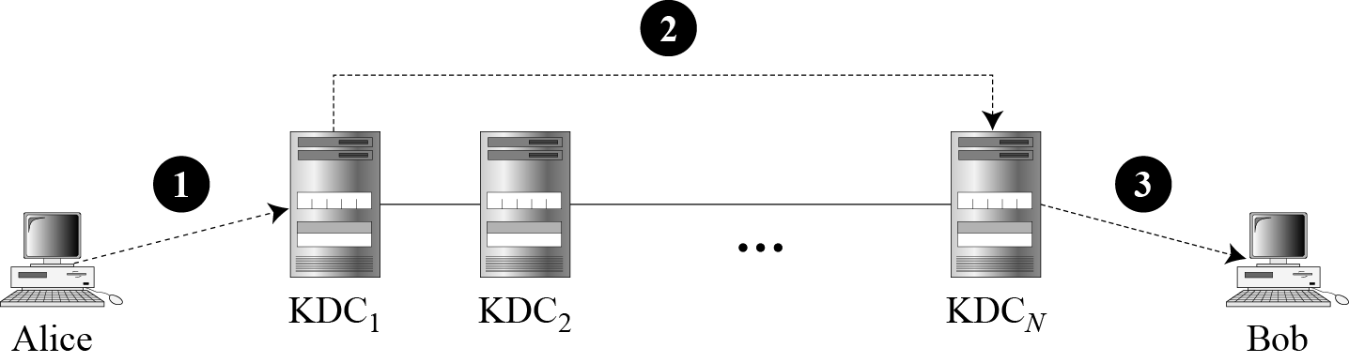
15.1.1 Continued
Flat Multiple KDCs.
Figure 15.2 Flat multiple KDCs
15.<number>

Slide 59
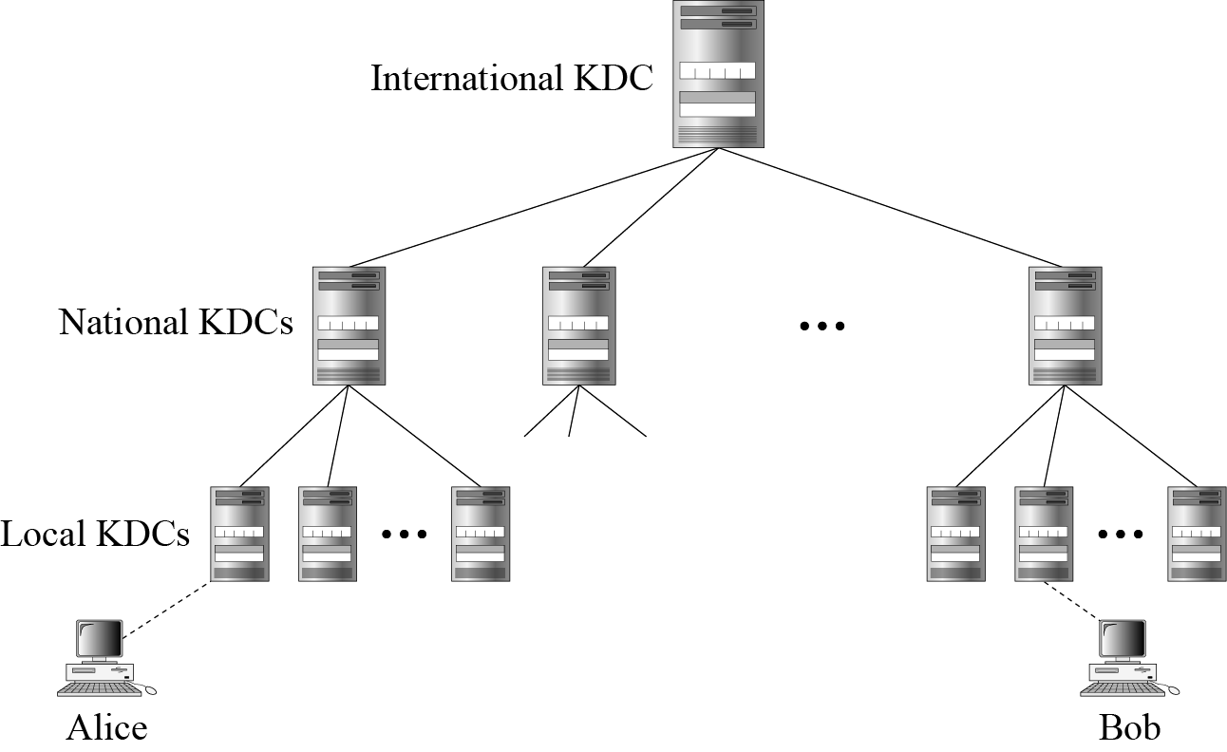
15.1.1 Continued
Hierarchical Multiple KDCs
Figure 15.3 Hierarchical multiple KDCs
15.<number>

Slide 60
15.1.2 Session Keys
A KDC creates a secret key for each member. This secret key can be used only between the member and the KDC, not between two members.
Note
A session symmetric key between two parties is used only once.
15.<number>

Slide 61
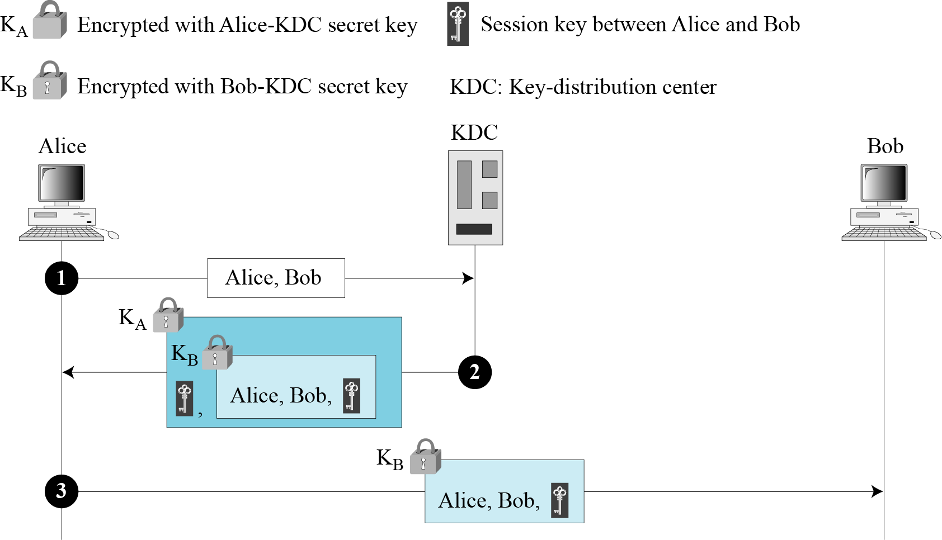
15.1.2 Continued
A Simple Protocol Using a KDC
Figure 15.4 First approach using KDC
15.<number>

Slide 62
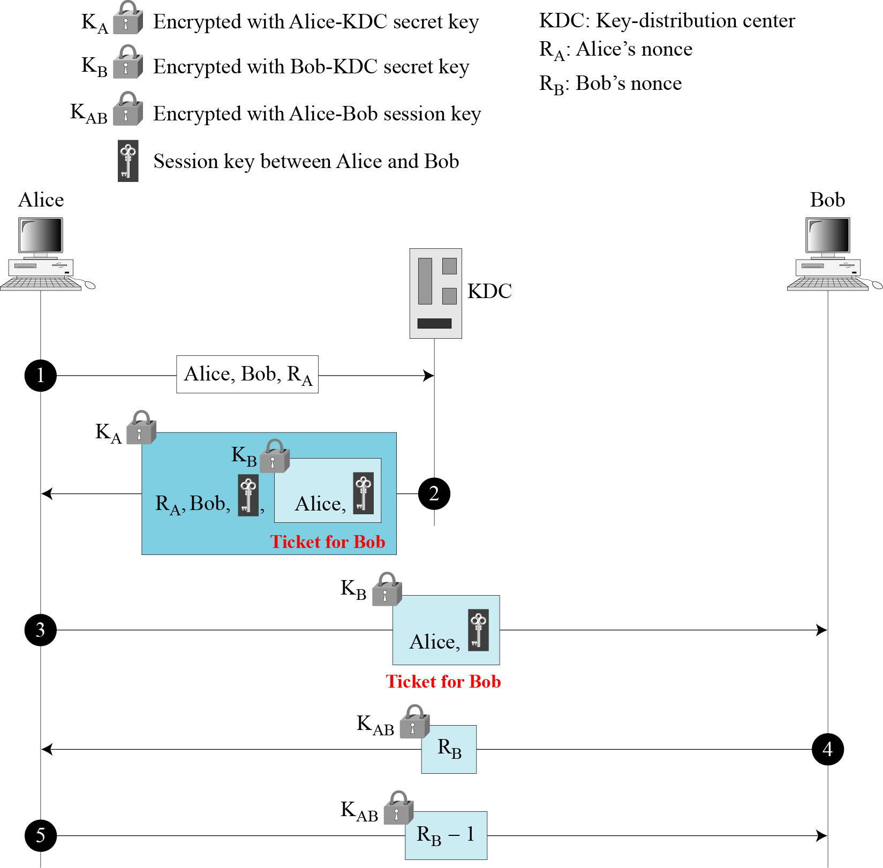
15.1.2 Continued
Needham-Schroeder Protocol
Figure 15.5
Needham-Schroeder
protocol
15.<number>

Slide 63
15-2 KERBEROS
A backbone network allows several LANs to be connected. In a backbone network, no station is directly connected to the backbone; the stations are part of a LAN, and the backbone connects the LANs.
Kerberos is an authentication protocol, and at the same time a KDC, that has become very popular. Several systems, including Windows 2000, use Kerberos. Originally designed at MIT, it has gone through several versions.
Topics discussed in this section:
15.2.1 Servers
15.2.2 Operation
15.2.3 Using Different Servers
15.2.4 Kerberos Version 5
14.2.5 Realms
15.<number>

Slide 64
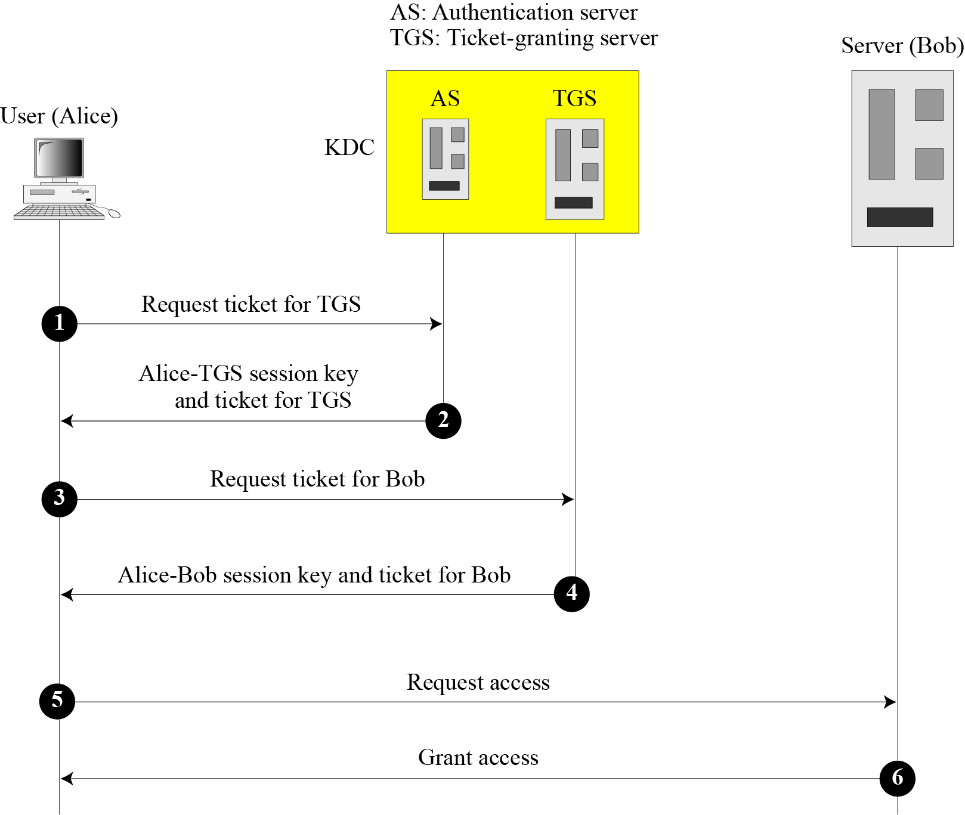
15.2.1 Servers
Figure 15.7 Kerberos servers
15.<number>

Slide 65
15.2.1 Continued
Authentication Server (AS)
The authentication server (AS) is the KDC in the Kerberos protocol.
Ticket-Granting Server (TGS)
The ticket-granting server (TGS) issues a ticket for the real server (Bob).
Real Server
The real server (Bob) provides services for the user (Alice).
15.<number>

Slide 66
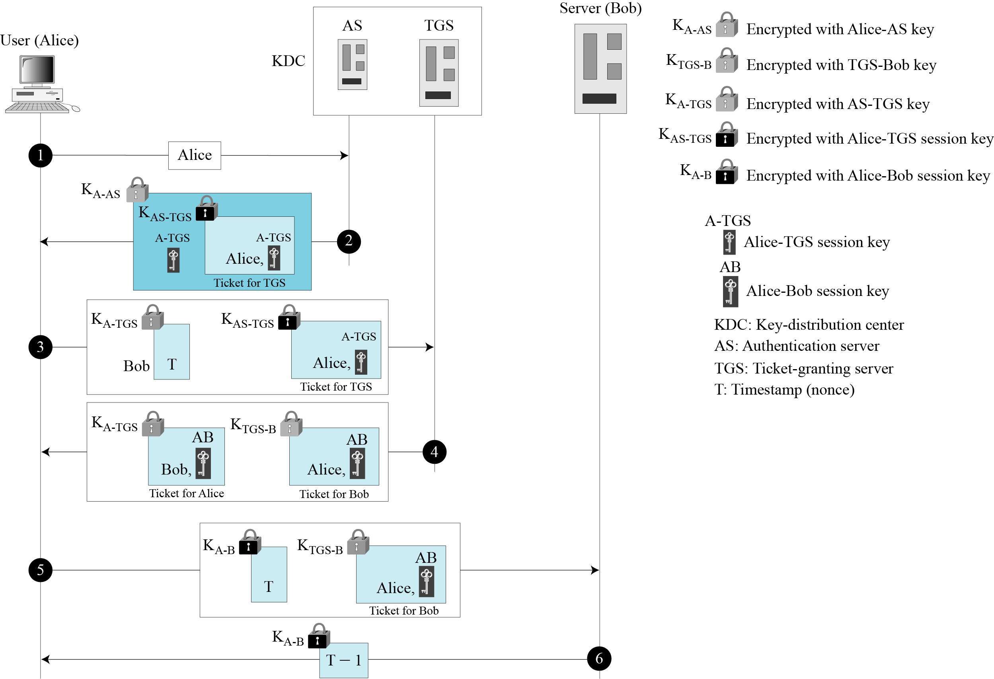
15.2.2 Operation
Figure 15.8 Kerberos example
15.<number>

Slide 67
15.2.3 Using Different Servers
Note that if Alice needs to receive services from different servers, she need repeat only the last four steps.
15.<number>

Slide 68
15.2.4 Kerberos Version 5
The minor differences between version 4 and version 5 are briefly listed below:
Version 5 has a longer ticket lifetime.
Version 5 allows tickets to be renewed.
Version 5 can accept any symmetric-key algorithm.
Version 5 uses a different protocol for describing data types.
Version 5 has more overhead than version 4.
15.<number>

Slide 69
15.2.5 Realms
Kerberos allows the global distribution of ASs and TGSs, with each system called a realm. A user may get a ticket for a local server or a remote server.
15.<number>

Slide 70
15-3 SYMMETRIC-KEY AGREEMENT
Alice and Bob can create a session key between themselves without using a KDC. This method of session-key creation is referred to as the symmetric-key agreement.
Topics discussed in this section:
15.3.1 Diffie-Hellman Key Agreement
15.3.2 Station-to-Station Key Agreement
15.<number>

Slide 71
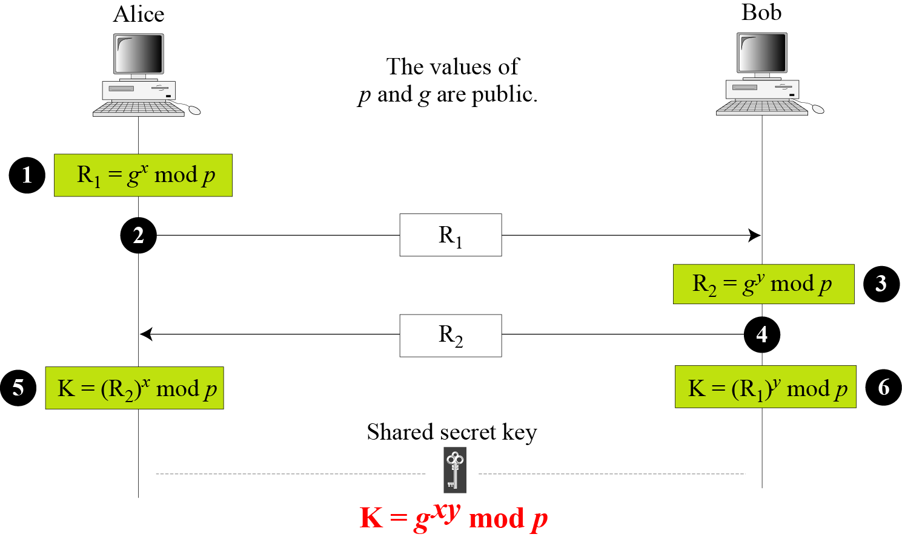
15.3.1 Diffie-Hellman Key Agreement
Figure 15.9 Diffie-Hellman method
15.<number>

Slide 72
15.3.1 Continued
Note
The symmetric (shared) key in the Diffie-Hellman method is K = g^{xy} mod p.
15.<number>

Slide 73
15.3.1 Continued
Example 15.1
Let us give a trivial example to make the procedure clear. Our example uses small numbers, but note that in a real situation, the numbers are very large. Assume that g = 7 and p = 23. The steps are as follows:
Alice chooses x = 3 and calculates R₁ = 7^3 mod 23 = 21.
Bob chooses y = 6 and calculates R₂ = 7^6 mod 23 = 4.
Alice sends the number 21 to Bob.
Bob sends the number 4 to Alice.
Alice calculates the symmetric key K = 4^3 mod 23 = 18.
Bob calculates the symmetric key K = 21^6 mod 23 = 18.
The value of K is the same for both Alice and Bob;
15.<number>

Slide 74
15-4 PUBLIC-KEY DISTRIBUTION
In asymmetric-key cryptography, people do not need to know a symmetric shared key; everyone shields a private key and advertises a public key.
Topics discussed in this section:
15.4.1 Public Announcement
15.4.2 Trusted Center
15.4.3 Controlled Trusted Center
15.4.4 Certification Authority
15.4.5 X.509
15.4.6 Public-Key Infrastructures (PKI)
15.<number>

Slide 75
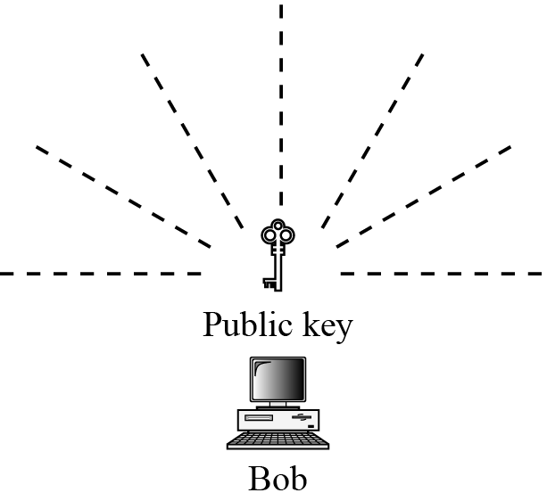
15.4.1 Public Announcement
Figure 15.13 Announcing a public key
15.<number>

Slide 76
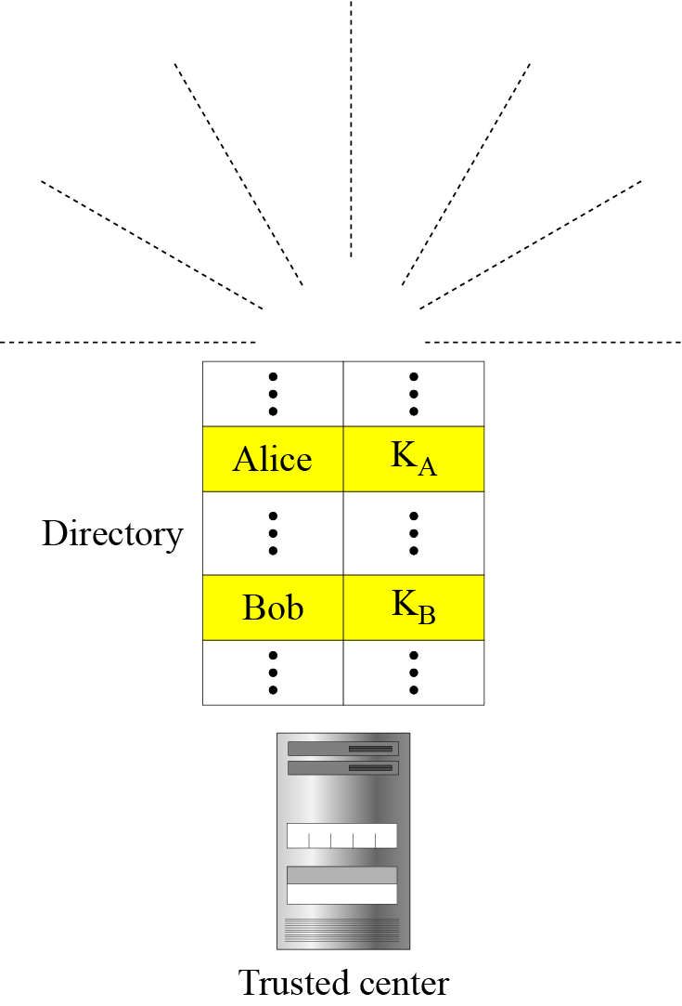
15.4.2 Trusted Center
Figure 15.14 Trusted center
15.<number>

Slide 77
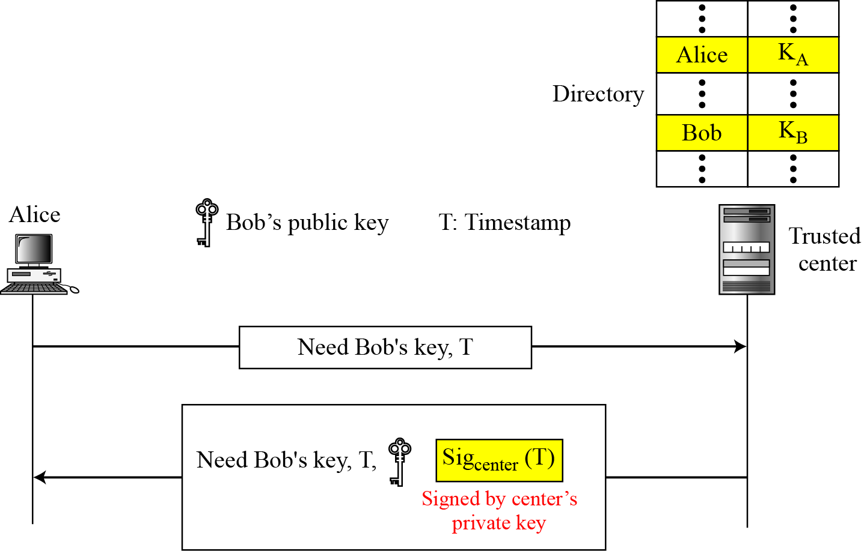
15.4.3 Controlled Trusted Center
Figure 15.15 Controlled trusted center
15.<number>

Slide 78
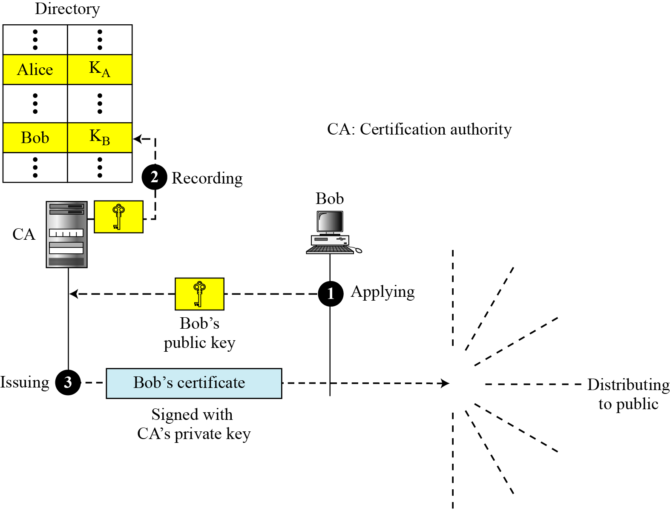
15.4.4 Certification Authority
Figure 15.16 Certification authority
15.<number>

Slide 79
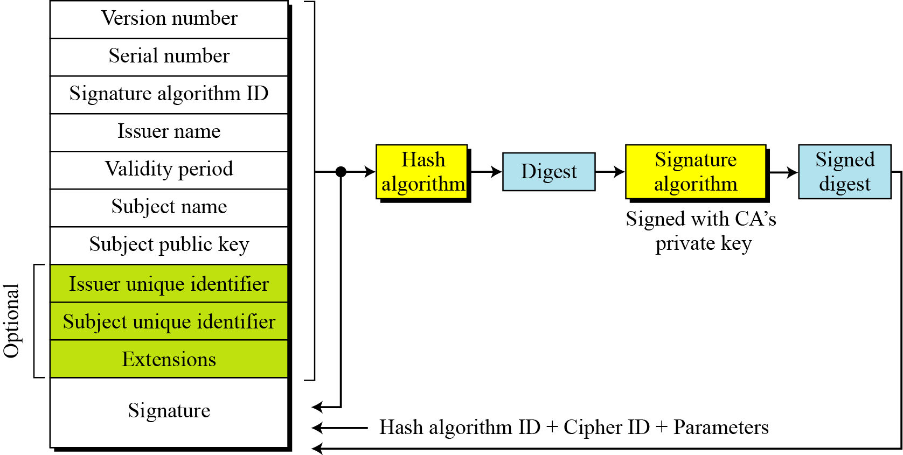
15.4.5 X.509
Certificate
Figure 15.17 shows the format of a certificate.
15.<number>

Slide 80
15.4.5 Continued
Certificate Renewal
Each certificate has a period of validity. If there is no problem with the certificate, the CA issues a new certificate before the old one expires.
Certificate Revocation
In some cases a certificate must be revoked before its expiration.
15.<number>

Slide 81
15.4.5 Continued
Various reasons for certification revocation:
1. The user’s private key is compromised.
2. The CA is no longer willing to certify the user.
3. The CA’s private key, which can verify certificates have been compromised.
15.<number>

Slide 82
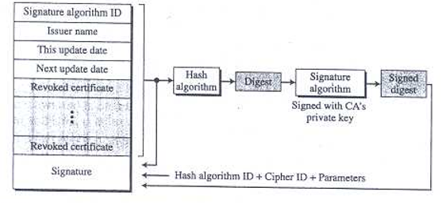
15.4.5 Continued
Figure 15.17 Certificate revocation format
Delta Revocation
To make revocation more efficient, the delta certificate revocation list (delta CRL) has been introduced.
Delta CRL contains only changes made after last CRL.
15.<number>

Slide 83
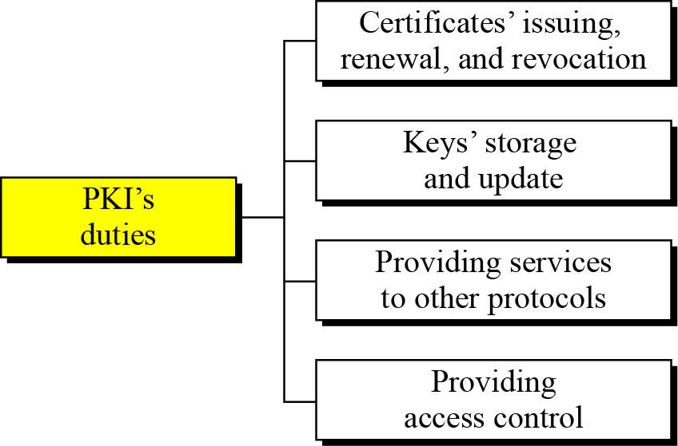
15.4.5 Continued
Public Key Infrastructure
PKI is a model for creating, distributing and revoking certificates based on X.509.
Duties of PKI are
15.<number>

Slide 84
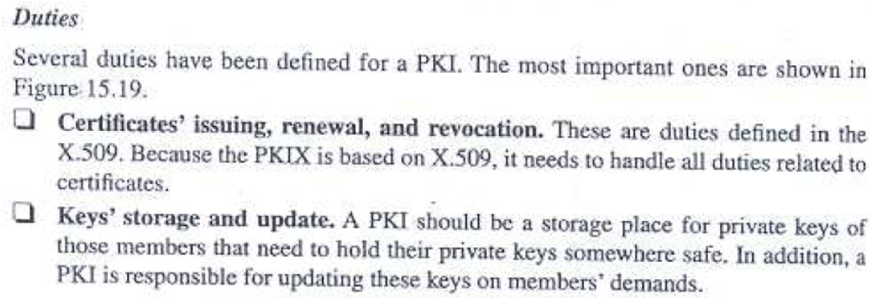
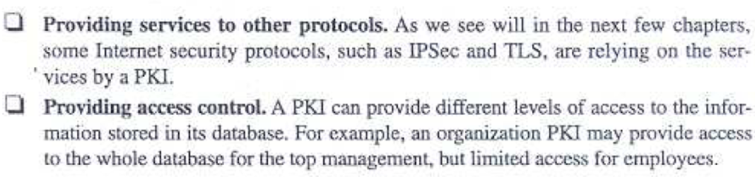
15.<number>

Slide 85
15.4.5 Continued
Trust Model
It is not possible to have just one CA issuing all certificates for all users.
There should me many CA’s each responsible for creating, storing, issuing and revoking a limited number of certificates.
The trust model defines rules that specify how a user can verify a certificate received from CA.
15.<number>

Slide 86
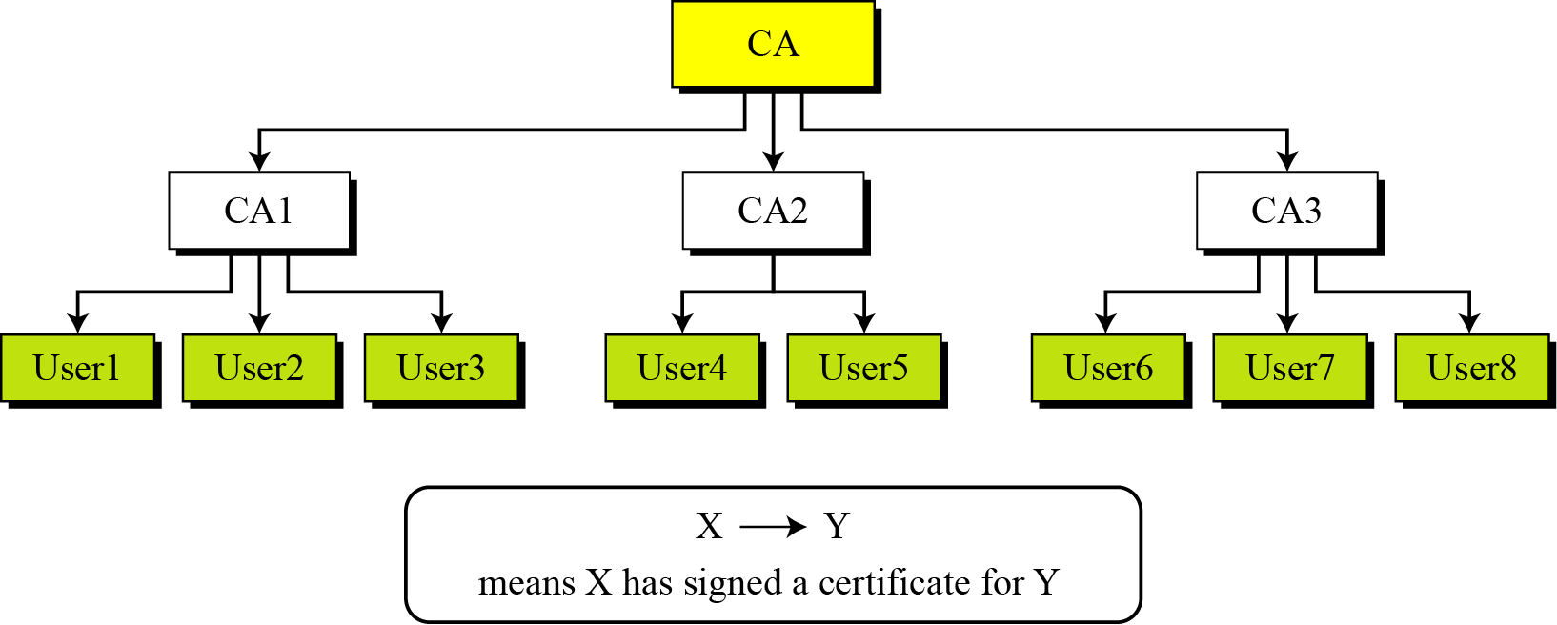
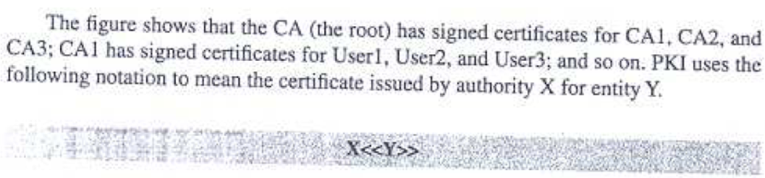
15.4.6 Continued
Trust Model
Figure 15.20 PKI hierarchical model
15.<number>

Slide 87
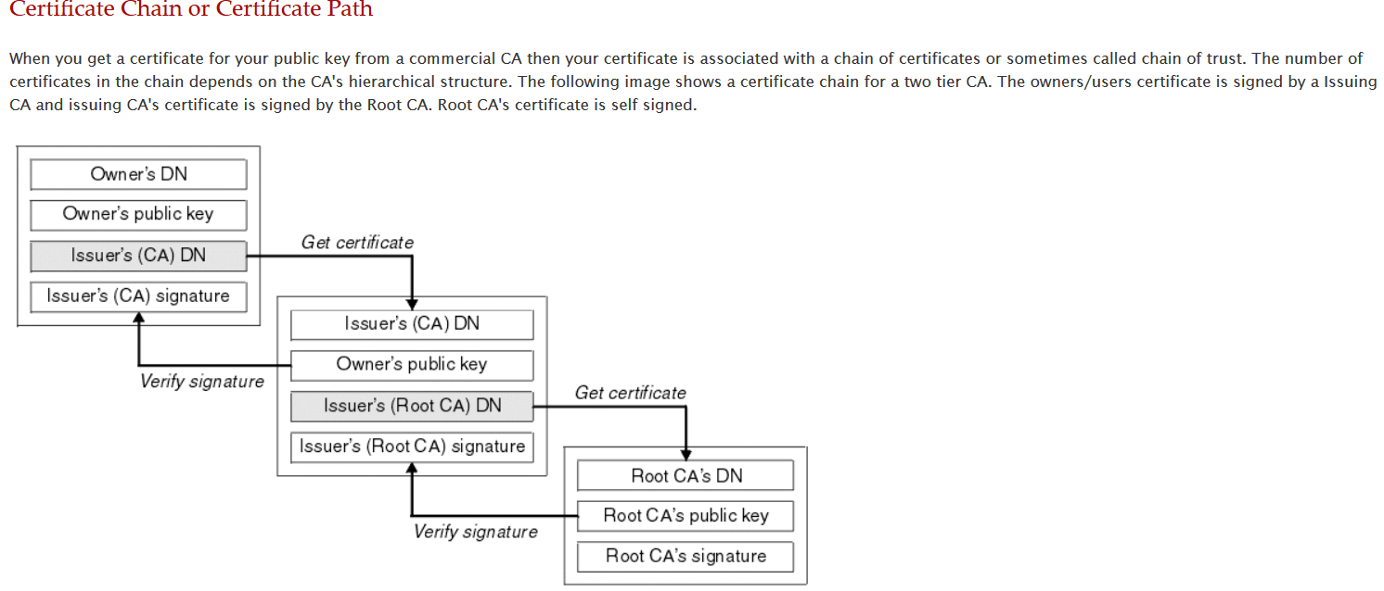
15.4.6 Continued
15.<number>

Slide 88
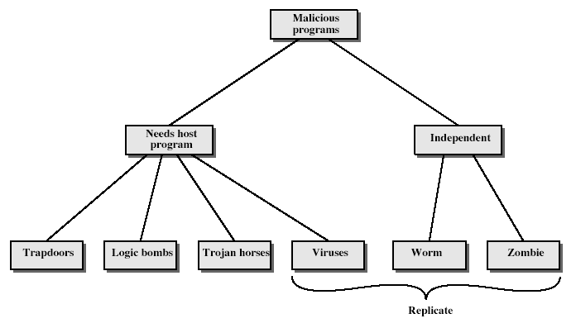
Malicious Programs
Notes:
Stallings Fig 19-1.
Taxonomy can be divided into two categories: those that need a host program, and those that are independent;
can also differentiate between those software threats that do not replicate and those that do.

Slide 89
Trapdoors
Secret entry point into a program.
Allows those who know access bypassing usual security procedures.
Have been commonly used by developers.
Threat when left in production programs, allowing exploited by attackers
Requires good s/w development & update.

Slide 90
Logic Bomb
One of oldest types of malicious software.
Code embedded in legitimate program.
Activated when specified conditions met.
  presence/absence of some file
  particular date/time
  particular user
When triggered typically damage system.
  modify/delete files/disks

Slide 91
Trojan Horse
Program with hidden side-effects.
Which is usually superficially attractive
  eg game, ZIP software etc.
When run performs some additional tasks
  allows attacker to indirectly gain access they do not have directly
Often used to propagate a virus/worm or install a backdoor or to destroy data.

Slide 92
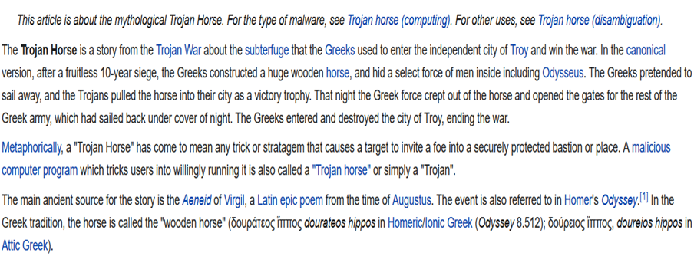

Trojan Horse

Slide 93
Zombie
Program which secretly takes over another networked computer then uses it to indirectly launch attacks.
Often used to launch distributed denial of service (DDoS) attacks.

Slide 94
Viruses
A virus is a piece of software that can "infect" other programs by modifying them.
The modification includes a copy of the virus program, which can then go on to infect other programs.
A virus can be pre-pended or post-pended to an executable program.
The key to its operation is that the infected program, when invoked, will first execute the virus code and then execute the original code of the program.
The virus may perform some action, usually detrimental to the system. This action could be a logic bomb that triggers only under certain conditions.
If the infection phase of the program is reasonably rapid, a user is unlikely to notice any difference between the execution of an infected and uninfected program.

Slide 95
Types of Viruses
Parasitic virus: The traditional and still most common form of virus. A parasitic virus attaches itself to executable files and replicates, when the infected program is executed, by finding other executable files to infect.
Memory-resident virus: Lodges in main memory as part of a resident system program. From that point on, the virus infects every program that executes.
Boot sector virus: Infects a master boot record or boot record and spreads when a system is booted from the disk containing the virus.

Slide 96
Types of Viruses
Stealth virus: A form of virus explicitly designed to hide itself from detection by antivirus software. For ex: Using compression to hide increased file size due to infection.
Polymorphic virus: A virus that mutates with every infection, making detection by the "signature" of the virus impossible. For ex: To insert superfluous instructions or change the order of independent instructions.

Slide 97
E-mail Virus
The first rapidly spreading e-mail viruses, such as Melissa, made use of a Microsoft Word macro embedded in an attachment.
If the recipient opens the e-mail attachment, the Word macro is activated.
Then e-mail virus sends itself to everyone on the mailing list in the user's e-mail package.
Later, more powerful version of the e-mail virus appeared, which can be activated merely by opening an e-mail.
Ultimately, a greater degree of security must be built into Internet utility and application software on PCs to counter the growing threat.

Slide 98
Worms
A worm is a program that can replicate itself and send copies from computer to computer across network connections. Upon arrival, the worm may be activated to replicate and propagate. Also, the worm usually performs some unwanted function.
An e-mail virus has some of the characteristics of a worm, however, we can still classify it as a virus because it requires a human to move it forward. To replicate itself, a network worm uses some sort of network vehicle. For ex. : Electronic mail facility, Remote login capability etc.
The new copy of the worm program is then run on the remote system continues to spread in the same fashion.
Ex: Stuxnet is a malicious computer worm, first uncovered in 2010. Thought to have been in development since at least 2005, Stuxnet targets SCADA systems and is believed to be responsible for causing substantial damage to Iran's nuclear program. Although neither country has openly admitted responsibility, the worm is believed to be a jointly built American/Israeli cyberweapon.^{[1][2]}

Slide 99
Worms
How to tell if your computer has a worm
If you suspect your devices are infected with a computer worm, run a virus scan immediately. Even if the scan comes up negative, continue to be proactive by following these steps.
Keep an eye on your hard drive space. When worms repeatedly replicate themselves, they start to use up the free space on your computer.
Monitor speed and performance. Has your computer seemed a little sluggish lately? Are some of your programs crashing or not running properly? That could be a red flag that a worm is eating up your processing power.
Be on the lookout for missing or new files. One function of a computer worm is to delete and replace files on a computer.

Slide 100
‘Melissa’ & ‘I Love You’ Virus
In the third month of the year 1999, the Melissa virus was circulated in the online space as an e-mail attachment. This fast-spreading macro virus when opened disabled a number of security features in Word 97 or Word 2000. In the case of users who had the MS Outlook e-mail program, aided the virus to be resent to the first 50 people in each of the user’s address books
The ILOVEYOU virus was set free in the wild from the Philipines very soon after the Melissa virus issue was settled. It attacked tens of millions of Windows PCs on and after 5th of May 2000. Notably, while the ‘Melissa’ was a virus attack, the ILOVEYOU digital menace came in the form of a worm virus. The ILOVEYOU virus sometimes related to as Love Letter or Love Bug, was triggered as an email message with the subject line “ILOVEYOU” and the attachment “LOVE-LETTER-FOR-YOU.txt.vbs”.
The ‘VBS’ was mistaken by users as a normal text file, however, the ‘VBS’ actually the VBScript program which the hackers used to create the worm. Victims who unintentionally opened the attachment activated the Visual Basic script. The malicious program quickly started to overwrite random types of files, and that included image, office, and audio files. But the virus would hide the file after overwriting MP3 files and sent out emails to all addresses in the Windows Address Book attaching the copy of itself.
A brief comparison, the previously explained Melissa virus sent copies to the first 50 contacts on the address book but the ILOVEYOU virus sent out emails to all email addresses in the Windows Address Book. As a result, the ILOVEYOU virus spread much faster than any other previous email worm.

Slide 101
Firewall
A firewall is a hardware device or a software program located at the network gateway server and used for secure communication between different networks according to a specified security policy.
A firewall provides a line of defense, against attacks on an internal network from an external network.
What does a Firewall do
  Prevent Network Scanning.
  Controls Traffic.
  Perform users authentication.
  Filters Packets, Services and Protocols.
  Performs Traffic logging.
  Performs Network Address Translation(NAT).
  Prevents malware attacks.

Slide 102

Firewall
A choke point of control and monitoring.
Only authorized traffic is allowed.
Auditing and controlling access.
implement VPNs using IPSec.
Notes:
A firewall is inserted between the premises network and the Internet to establish a controlled link and to erect an outer security wall or perimeter, forming a single choke point where security and audit can be imposed. A firewall:
defines a single choke point that keeps unauthorized users out of the protected network, prohibits potentially vulnerable services from entering or leaving the network, and provides protection from various kinds of IP spoofing and routing attacks.
2. provides a location for monitoring security-related events
3. is a convenient platform for several Internet functions that are not security related, such as NAT and Internet usage audits or logs
4. A firewall can serve as the platform for IPSec to implement virtual private networks.
The firewall itself must be immune to penetration, since it will be a target of attack.

Slide 103
Functions of Firewall
A firewall examines all the traffic flowing through it to see if it meets the firewall rule set criteria.
It blocks identified packets between the networks that are matched to a deny rule.
It filters both inbound and outbound traffic.
It logs all attempts to enter the private network and triggers alarms when hostile or unauthorized entry is attempted.
The functions of the firewall include gateway defense, carrying out defined security policies, hiding and protecting internal network addresses, reporting threats and activity, and segregating activity between trusted networks.

Slide 104
Firewall Limitation
A firewall does not prevent the network from backdoor attacks.
A firewall does not protect the network from insider attacks.
A firewall cannot do anything if the network design and configurations is faulty.
A firewall is not an alternative to antivirus or antimalware.

Slide 105
A firewall cannot prevent social engineering threats.
A firewall does not prevent password misuse.
A firewall does not block attacks from a higher level of the protocol stack.
A firewall does not protect against attack originating from common ports and applications.
A firewall does not protect against attack from dial-up connection.
13.<number>

Slide 106

Packet Filter Firewall
Types of firewalls: Packet filters, Application-level gateways, & Circuit-level gateways, Stateful Inspection Firewall.
A packet-filtering router applies a set of rules to each incoming and outgoing IP packet to forward or discard the packet. Filtering rules are based on information contained in a network packet.

Slide 107

Packet Filter Firewall

Slide 108
Application-level Gateway
An Application level gateway, also called a proxy server.
The user contacts the gateway using a TCP/IP application, such as Telnet or FTP, and the gateway asks the user for the name of the remote host to be accessed.
When the user responds and provides a valid user ID and authentication information, the gateway contacts the application on the remote host and relays TCP segments containing the application data between the two endpoints.
A prime disadvantage is the additional processing overhead on each connection.

Slide 109
Application-level Gateway

Slide 110
Circuit-Level Gateway
Circuit level gateway can be a stand-alone system or it can be a specified function performed by an application level gateway for certain applications.
A Circuit level gateway does not permit an end-to-end TCP connection; rather, the gateway sets up two TCP connections.
One between itself and a TCP user on an inner host and one between itself and a TCP user on an outer host.
Once the two connections are established, the gateway typically relays TCP segments from one connection to the other without examining the contents.

Slide 111

Circuit-Level Gateway

Slide 112
Stateful Inspection Firewall
When an application that uses TCP creates a session with a remote host, it creates a TCP connection in which the TCP port number for the remote (server) application is a number less than 1024 and the TCP port number for the local (client) application is a number between 1024 and 65535.
A simple packet filtering firewall must permit inbound network traffic on all these high-numbered ports for TCP-based traffic to occur. This creates a vulnerability that can be exploited by unauthorized users.
A stateful inspection packet firewall tightens up the rules for TCP traffic by creating a directory of outbound TCP connections.
The packet filter will now allow incoming traffic to high-numbered ports only for those packets that fit the profile of one of the entries in this directory.

Slide 113
Firewall Location & Management
A security administrator must decide on the location and number of firewall needed.
Bastion Host: A bastion host is a computer system designed and configured to protect network resources from an attack and it is placed between two networks where it acts as an application level gateway.
Screened Subnet: Screened subnet or DMZ (additional zone ) contains hosts that offer public services. The public zone is connected directly to the internet and has no host which are controlled by the organization.
Multi-homed Firewall: This type of fire wall consist of three interfaces which allow for further subdividing of the system based on specific security objects in the organization.

Slide 114

Firewall Location & Management
A security administrator must decide on the location and number of firewall needed.

Slide 115
E-mail Security- Pretty Good Privacy (PGP)
Provides a confidentiality and authentication service that can be used for electronic mail and file storage applications
Developed by Phil Zimmermann
  Selected the best available cryptographic algorithms as building blocks
  Integrated these algorithms into a general-purpose application that is independent of operating system and processor and that is based on a small set of easy-to-use commands
  Made the package and its documentation, including the source code, freely available via the Internet, bulletin boards, and commercial networks
  Entered into an agreement with a company to provide a fully compatible, low-cost commercial version of PGP
Notes:
PGP is a remarkable phenomenon. Largely the effort of a single person, Phil
Zimmermann, PGP provides a confidentiality and authentication service that can
be used for electronic mail and file storage applications. In essence, Zimmermann
has done the following:
1. Selected the best available cryptographic algorithms as building blocks.
2. Integrated these algorithms into a general-purpose application that is independent
of operating system and processor and that is based on a small set of
easy-to-use commands.
3. Made the package and its documentation, including the source code, freely
available via the Internet, bulletin boards, and commercial networks such as
AOL (America On Line).
4. Entered into an agreement with a company (Viacrypt, now Network
Associates) to provide a fully compatible, low-cost commercial version of PGP.

Slide 116

Summary of PGP Services
Notes:
The actual operation of PGP, as opposed to the management of keys, consists of
four services: authentication, confidentiality, compression, and e-mail compatibility
(Table 19.1).

Slide 117
PGP Authentication
Combination of SHA-1 and RSA provides an effective digital signature scheme
  Because of the strength of RSA the recipient is assured that only the possessor of the matching private key can generate the signature
  Because of the strength of SHA-1 the recipient is assured that no one else could generate a new message that matches the hash code
  As an alternative, signatures can be generated using DSS/SHA-1
Notes:
The combination of SHA-1 and RSA provides an effective digital signature
scheme. Because of the strength of RSA, the recipient is assured that only the possessor
of the matching private key can generate the signature. Because of the strength
of SHA-1, the recipient is assured that no one else could generate a new message
that matches the hash code and, hence, the signature of the original message.
As an alternative, signatures can be generated using DSS/SHA-1.
Although signatures normally are found attached to the message or file that
they sign, this is not always the case: Detached signatures are supported. A detached
signature may be stored and transmitted separately from the message it signs. This
is useful in several contexts. A user may wish to maintain a separate signature log of
all messages sent or received. A detached signature of an executable program can
detect subsequent virus infection. Finally, detached signatures can be used when
more than one party must sign a document, such as a legal contract. Each person’s
signature is independent and therefore is applied only to the document. Otherwise,
signatures would have to be nested, with the second signer signing both the document
and the first signature, and so on.

Slide 118

PGP Confidentiality
Provided by encrypting messages to be transmitted or to be stored locally as files
  In both cases the symmetric encryption algorithm CAST-128 may be used
  Alternatively IDEA or 3DES may be used
  The 64-bit cipher feedback (CFB) mode is used
  As an alternative to the use of RSA for key encryption, PGP uses ElGamal, a variant of Diffie-Hellman that provides encryption/decryption
Notes:
Another basic service provided by PGP is confidentiality, which
is provided by encrypting messages to be transmitted or to be stored locally as
files. In both cases, the symmetric encryption algorithm CAST-128 may be used.
Alternatively, IDEA or 3DES may be used. The 64-bit cipher feedback (CFB)
mode is used.
As always, one must address the problem of key distribution. In PGP, each
symmetric key is used only once. That is, a new key is generated as a random 128-bit
number for each message. Thus, although this is referred to in the documentation
as a session key, it is in reality a one-time key. Because it is to be used only once,
the session key is bound to the message and transmitted with it. To protect the key,
it is encrypted with the receiver’s public key. Figure 19.1b illustrates the sequence.
As an alternative to the use of RSA for key encryption, PGP provides an option
referred to as Diffie-Hellman . As was explained in Chapter 10, Diffie-Hellman
is a key exchange algorithm. In fact, PGP uses a variant of Diffie-Hellman that does
provide encryption/decryption, known as ElGamal (Chapter 10).
Several observations may be made. First, to reduce encryption time, the combination
of symmetric and public-key encryption is used in preference to simply
using RSA or ElGamal to encrypt the message directly: CAST-128 and the other
symmetric algorithms are substantially faster than RSA or ElGamal. Second, the
use of the public-key algorithm solves the session-key distribution problem, because
only the recipient is able to recover the session key that is bound to the message.
Note that we do not need a session-key exchange protocol of the type discussed in
Chapter 14, because we are not beginning an ongoing session. Rather, each message
is a one-time independent event with its own key. Furthermore, given the store-andforward
nature of electronic mail, the use of handshaking to assure that both sides
have the same session key is not practical. Finally, the use of one-time symmetric
keys strengthens what is already a strong symmetric encryption approach. Only a
small amount of plaintext is encrypted with each key, and there is no relationship
among the keys. Thus, to the extent that the public-key algorithm is secure, the
entire scheme is secure. To this end, PGP provides the user with a range of key size
options from 768 to 3072 bits (the DSS key for signatures is limited to 1024 bits).

Slide 119

PGP Confidentiality and Authentication
Both services may be used for the same message
  First a signature is generated for the plaintext message and prepended to the message
  Then the plaintext message plus signature is encrypted using CAST-128 (or IDEA or 3DES) and the session key is encrypted using RSA (or ElGamal)
When both services are used:
Notes:
As Figure 19.1c illustrates, both services
may be used for the same message. First, a signature is generated for the plaintext
message and prepended to the message. Then the plaintext message plus signature
is encrypted using CAST-128 (or IDEA or 3DES), and the session key is encrypted
using RSA (or ElGamal). This sequence is preferable to the opposite: encrypting
the message and then generating a signature for the encrypted message. It is generally
more convenient to store a signature with a plaintext version of a message.
Furthermore, for purposes of third-party verification, if the signature is performed
first, a third party need not be concerned with the symmetric key when verifying the
signature.
In summary, when both services are used, the sender first signs the message
with its own private key, then encrypts the message with a session key, and finally
encrypts the session key with the recipient’s public key.

Slide 120

Notes:
Figure 19.1a illustrates the digital signature service provided by
PGP. This is the digital signature scheme discussed in Chapter 13 and illustrated in
Figure 13.2.
To protect the key, it is encrypted with the receiver’s public key. Figure 19.1b illustrates the sequence.
As Figure 19.1c illustrates, both services
may be used for the same message. First, a signature is generated for the plaintext
message and prepended to the message. Then the plaintext message plus signature
is encrypted using CAST-128 (or IDEA or 3DES), and the session key is encrypted
using RSA (or ElGamal). This sequence is preferable to the opposite: encrypting
the message and then generating a signature for the encrypted message. It is generally
more convenient to store a signature with a plaintext version of a message.
Furthermore, for purposes of third-party verification, if the signature is performed
first, a third party need not be concerned with the symmetric key when verifying the
signature.
In summary, when both services are used, the sender first signs the message
with its own private key, then encrypts the message with a session key, and finally
encrypts the session key with the recipient’s public key.

Slide 121
PGP Compression
As a default, PGP compresses the message after applying the signature but before encryption
  This has the benefit of saving space both for e-mail transmission and for file storage
  The placement of the compression algorithm is critical
    It is preferable to sign an uncompressed message so that one can store only the uncompressed message together with the signature for future verification.
    Message encryption is applied after compression to strengthen cryptographic security
  The compression algorithm used is ZIP
Notes:
As a default, PGP compresses the message after applying the signature
but before encryption. This has the benefit of saving space both for e-mail
transmission and for file storage.
The placement of the compression algorithm is critical.
1. The signature is generated before compression for two reasons:
a. It is preferable to sign an uncompressed message so that one can store only
the uncompressed message together with the signature for future verification.
If one signed a compressed document, then it would be necessary either
to store a compressed version of the message for later verification or to
recompress the message when verification is required.
b. Even if one were willing to generate dynamically a recompressed message
for verification, PGP’s compression algorithm presents a difficulty. The
algorithm is not deterministic; various implementations of the algorithm
achieve different tradeoffs in running speed versus compression ratio and,
as a result, produce different compressed forms. However, these different
compression algorithms are interoperable because any version of the algorithm
can correctly decompress the output of any other version. Applying
the hash function and signature after compression would constrain all PGP
implementations to the same version of the compression algorithm.
2. Message encryption is applied after compression to strengthen cryptographic
security. Because the compressed message has less redundancy than the original
plaintext, cryptanalysis is more difficult.
The compression algorithm used is ZIP, which is described in Appendix O.

Slide 122
PGP E-mail Compatibility
Many electronic mail systems only permit the use of blocks consisting of ASCII text
  To accommodate this restriction, PGP provides the service of converting the raw 8-bit binary stream to a stream of printable ASCII characters
  The scheme used for this purpose is radix-64 conversion
    Each group of three octets of binary data is mapped into four ASCII characters
    This format also appends a CRC to detect transmission errors
Notes:
When PGP is used, at least part of the block to be transmitted
is encrypted. If only the signature service is used, then the message digest is
encrypted (with the sender’s private key). If the confidentiality service is used, the
message plus signature (if present) are encrypted (with a one-time symmetric key).
Thus, part or all of the resulting block consists of a stream of arbitrary 8-bit octets.
However, many electronic mail systems only permit the use of blocks consisting of
ASCII text. To accommodate this restriction, PGP provides the service of converting
the raw 8-bit binary stream to a stream of printable ASCII characters.
The scheme used for this purpose is radix-64 conversion. Each group of three
octets of binary data is mapped into four ASCII characters. This format also appends
a CRC to detect transmission errors. See Appendix 19A for a description.
The use of radix 64 expands a message by 33%. Fortunately, the session key
and signature portions of the message are relatively compact, and the plaintext message
has been compressed. In fact, the compression should be more than enough to
compensate for the radix-64 expansion. For example, [HELD96] reports an average
compression ratio of about 2.0 using ZIP. If we ignore the relatively small signature
and key components, the typical overall effect of compression and expansion of a
file of length X would be 1.33 * 0.5 * X = 0.665 * X . Thus, there is still an overall
compression of about one-third.
One noteworthy aspect of the radix-64 algorithm is that it blindly converts the
input stream to radix-64 format regardless of content, even if the input happens to
be ASCII text. Thus, if a message is signed but not encrypted and the conversion
is applied to the entire block, the output will be unreadable to the casual observer,
which provides a certain level of confidentiality. As an option, PGP can be configured
to convert to radix-64 format only the signature portion of signed plaintext
messages. This enables the human recipient to read the message without using PGP.
PGP would still have to be used to verify the signature.

Slide 123

Radix 64 Conversion
Henric Johnson

Slide 124

Radix 64 Conversion
Henric Johnson

Slide 125

Radix 64 Conversion
Henric Johnson

Slide 126

Radix 64 Conversion

Slide 127

Example

Slide 128

Format of PGP Message
Henric Johnson

Slide 129

Key Rings
Henric Johnson

Slide 130
16.2.3 PGP Certificates
X.509 Certificates
Protocols that use X.509 certificates depend on the hierarchical structure of the trust.
Note
In X.509, there is a single path from the fully trusted authority to any certificate.
16.<number>

Slide 131
16.2.3 Continued
PGP Certificates
In PGP, there is no need for CAs; anyone in the ring can sign a certificate for anyone else in the ring.
Note
In PGP, there can be multiple paths from fully or partially trusted authorities to any subject.
Trusts and Legitimacy
The entire operation of PGP is based on introducer trust, the certificate trust, and the legitimacy of the public keys.
16.<number>

Slide 132
16.2.3 Continued
Trust & Legitimacy
Introducer trust: It specifies the trust levels issued by introducer for other people in the ring. There are three levels for introducer trust- fully, partial & none.
Certificate trust: Certificate trust is normally the same as the introducer trust.
Key legitimacy: The purpose of using introducer and certificate trusts is to determine the legitimacy of a public key.
16.<number>

Slide 133

16.2.3 Continued
Figure 16.7 Format of private key ring table
16.<number>

Slide 134

16.2.3 Continued
Example 16.1
Let us show a private key ring table for Alice. We assume that Alice has only two user IDs, alice@some.com and alice@anet.net. We also assume that Alice has two sets of private/public keys, one for each user ID.
16.<number>

Slide 135

16.2.3 Continued
Figure 16.8 Format of a public key ring table
16.<number>

Slide 136


16.2.3 Continued
Example 16.2
A series of steps will show how a public key ring table is formed for Alice.
16.<number>

Slide 137


16.2.3 Continued
Example 16.2
Continued
16.<number>

Slide 138

16.2.3 Continued
Example 16.2
Continued
16.<number>

Slide 139

16.2.3 Continued
Example 16.2
Continued
16.<number>

Slide 140
16-3 S/MIME
Another security service designed for electronic mail is Secure/Multipurpose Internet Mail Extension (S/MIME). The protocol is an enhancement of the Multipurpose Internet Mail Extension (MIME) protocol.
Topics discussed in this section:
16.3.1 MIME
16.3.2 S/MIME
16.3.3 Applications of S/MIME
16.<number>

Slide 141

16.3.1 Continued
Figure 16.23 MIME
16.<number>

Slide 142
Multipurpose Internet Mail Extensions (MIME)
An extension to the RFC 5322 framework that is intended to address some of the problems and limitations of the use of Simple Mail Transfer Protocol (SMTP)
  SMTP cannot transmit executable files or other binary objects.
  SMTP cannot transmit text data that includes national language characters because there are represented by 8-bit codes and SMTP is restricted to 7-bit ASCII.
  SMTP servers may reject mail messages over a certain size.
  MIME is intended to resolve these problems that is compatible with RFC 5322 implementation.
Notes:
Multipurpose Internet Mail Extension (MIME) is an extension to the RFC 5322
framework that is intended to address some of the problems and limitations of the
use of Simple Mail Transfer Protocol (SMTP), defined in RFC 821, or some other
mail transfer protocol and RFC 5322 for electronic mail.
MIME is intended to resolve these problems in a manner that is compatible
with existing RFC 5322 implementations. The specification is provided in RFCs
2045 through 2049.
The MIME specification includes the following elements.
1. Five new message header fields are defined, which may be included in an
RFC 5322 header. These fields provide information about the body of the
message.
2. A number of content formats are defined, thus standardizing representations
that support multimedia electronic mail.
3. Transfer encodings are defined that enable the conversion of any content format
into a form that is protected from alteration by the mail system.

Slide 143

S/MIME Functionality
Notes:
In terms of general functionality, S/MIME is very similar to PGP. Both offer the
ability to sign and/or encrypt messages. In this subsection, we briefly summarize
S/MIME capability. We then look in more detail at this capability by examining
message formats and message preparation.
S/MIME provides the following functions.
• Enveloped data: This consists of encrypted content of any type and encrypted content
encryption keys for one or more recipients.
• Signed data: A digital signature is formed by taking the message digest of
the content to be signed and then encrypting that with the private key of
the signer. The content plus signature are then encoded using base64 encoding.
A signed data message can only be viewed by a recipient with S/MIME
capability.
• Clear-signed data: As with signed data, a digital signature of the content is
formed. However, in this case, only the digital signature is encoded using
base64. As a result, recipients without S/MIME capability can view the message
content, although they cannot verify the signature.
• Signed and enveloped data: Signed-only and encrypted-only entities may be
nested, so that encrypted data may be signed and signed data or clear-signed
data may be encrypted.

Slide 144

Table 19.5
Cryptographic
Algorithms
Used in
S/MIME
Notes:
Table 19.5 summarizes the cryptographic algorithms
used in S/MIME. S/MIME uses the following terminology taken from RFC 2119
(Key Words for use in RFCs to Indicate Requirement Levels ) to specify the requirement
level:
• MUST: The definition is an absolute requirement of the specification. An implementation
must include this feature or function to be in conformance with
the specification.
• SHOULD: There may exist valid reasons in particular circumstances to ignore
this feature or function, but it is recommended that an implementation include
the feature or function.
S/MIME incorporates three public-key algorithms. The Digital Signature
Standard (DSS) described in Chapter 13 is the preferred algorithm for digital signature.
S/MIME lists Diffie-Hellman as the preferred algorithm for encrypting
session keys; in fact, S/MIME uses a variant of Diffie-Hellman that does provide
encryption/decryption, known as ElGamal (Chapter 10). As an alternative, RSA,
described in Chapter 9, can be used for both signatures and session key encryption.
These are the same algorithms used in PGP and provide a high level of security. For
the hash function used to create the digital signature, the specification requires the
160-bit SHA-1 but recommends receiver support for the 128-bit MD5 for backward
compatibility with older versions of S/MIME. As we discussed in Chapter 11, there
is justifiable concern about the security of MD5, so SHA-1 is clearly the preferred
alternative.
For message encryption, three-key triple DES (tripleDES) is recommended,
but compliant implementations must support 40-bit RC2. The latter is a weak encryption
algorithm but allows compliance with U.S. export controls.
The S/MIME specification includes a discussion of the procedure for deciding
which content encryption algorithm to use. In essence, a sending agent has two
decisions to make. First, the sending agent must determine if the receiving agent is
capable of decrypting using a given encryption algorithm. Second, if the receiving
agent is only capable of accepting weakly encrypted content, the sending agent must
decide if it is acceptable to send using weak encryption. To support this decision
process, a sending agent may announce its decrypting capabilities in order of preference
for any message that it sends out. A receiving agent may store that information
for future use.

Slide 145
Web Security
Web now widely used by business, government, individuals
but Internet & Web are vulnerable
have a variety of threats
  integrity
  confidentiality
  denial of service
  authentication
need added security mechanisms
Notes:
The World Wide Web is widely used by businesses, government agencies, and many individuals. But the Internet and the Web are extremely vulnerable to compromises of various sorts, with a range of threats as shown briefly above, and in detail in Stallings Table 16.1. These can be described as passive attacks including eavesdropping on network traffic between browser and server and gaining access to information on a Web site that is supposed to be restricted; and active attacks including impersonating another user, altering messages in transit between client and server, and altering information on a Web site. The web needs added security mechanisms to address these threats.

Slide 146

Web Traffic Security Approaches
Notes:
A number of approaches to providing Web security are possible. The various approaches that have been considered are similar in the services they provide and, to some extent, in the mechanisms that they use, but they differ with respect to their scope of applicability and their relative location within the TCP/IP protocol stack. Stallings Figure 16.1 illustrates this difference.
One way to provide Web security is to use IP Security (Figure 16.1a). The advantage of using IPSec is that it is transparent to end users and applications and provides a general-purpose solution. Further, IPSec includes a filtering capability so only selected traffic need incur the IPSec processing overhead.
Another relatively general-purpose solution is to implement security just above TCP (Figure 16.1b). The foremost example of this approach is the Secure Sockets Layer (SSL) and the follow-on Internet standard known as Transport Layer Security (TLS). At this level, there are two implementation choices. For full generality, SSL (or TLS) could be provided as part of the underlying protocol suite and therefore be transparent to applications. Alternatively, SSL can be embedded in specific packages, e.g. both the Netscape and Microsoft Explorer browsers come with SSL, & most Web servers have implemented it.
Application-specific security services are embedded within the particular application. Figure 16.1c shows examples of this architecture. The advantage of this approach is that the service can be tailored to the specific needs of a given application.

Slide 147
SSL (Secure Socket Layer)
transport layer security service
originally developed by Netscape
version 3 designed with public input
subsequently became Internet standard known as TLS (Transport Layer Security)
uses TCP to provide a reliable end-to-end service
SSL has two layers of protocols
Notes:
SSL probably most widely used Web security mechanism, and it is implemented at the Transport layer (cf. figure 16.1b on previous slide).
SSL is designed to make use of TCP to provide a reliable end-to-end secure service. Netscape originated SSL. Version 3 of the protocol was designed with public review and input from industry and was published as an Internet draft document. Subsequently, when a consensus was reached to submit the protocol for Internet standardization, the TLS working group was formed within IETF to develop a common standard. This first published version of TLS can be viewed as essentially an SSLv3.1 and is very close to and backward compatible with SSLv3. SSL is not a single protocol but rather two layers of protocol, as shown next.

Slide 148
SSL Architecture
SSL Session
  an association between client & server
  created by the Handshake Protocol
  define a set of cryptographic parameters
  may be shared by multiple SSL connections
SSL Connection
  a transient, peer-to-peer, communications link
  associated with 1 SSL session
Notes:
Two important SSL concepts are the SSL connection and the SSL session:
• Connection: A connection is a network transport that provides a suitable type of service, such connections are transient, peer-to-peer relationships, associated with one session
• Session: An SSL session is an association between a client and a server, created by the Handshake Protocol. Sessions define a set of cryptographic security parameters, which can be shared among multiple connections. Sessions are used to avoid the expensive negotiation of new security parameters for each connection.
Between any pair of parties (applications such as HTTP on client and server), there may be multiple secure connections. In theory, there may also be multiple simultaneous sessions between parties, but this feature is not used in practice.
There are a number of states associated with each session. Once a session is established, there is a current operating state for both read and write (i.e., receive and send). In addition, during the Handshake Protocol, pending read and write states are created. Upon successful conclusion of the Handshake Protocol, the pending states become the current states. A session state and a connection state are defined by sets of parameters, see text for details.

Slide 149


Session & Connection

Slide 150
SSL Architecture
Session state is defined by
  Session Identifier
  Peer Certificate
  Compression methods
  Cipher Spec
  Master Secret
  Is Resumable
Notes:
Two important SSL concepts are the SSL connection and the SSL session:
• Connection: A connection is a network transport that provides a suitable type of service, such connections are transient, peer-to-peer relationships, associated with one session
• Session: An SSL session is an association between a client and a server, created by the Handshake Protocol. Sessions define a set of cryptographic security parameters, which can be shared among multiple connections. Sessions are used to avoid the expensive negotiation of new security parameters for each connection.
Between any pair of parties (applications such as HTTP on client and server), there may be multiple secure connections. In theory, there may also be multiple simultaneous sessions between parties, but this feature is not used in practice.
There are a number of states associated with each session. Once a session is established, there is a current operating state for both read and write (i.e., receive and send). In addition, during the Handshake Protocol, pending read and write states are created. Upon successful conclusion of the Handshake Protocol, the pending states become the current states. A session state and a connection state are defined by sets of parameters, see text for details.

Slide 151
SSL Architecture
Connection state is defined by
  Server and Client Random
  Server write MAC secret
  Client write MAC secret
  Server write key
  Client write key
  Initialization vectors
  Sequence numbers
Notes:
Two important SSL concepts are the SSL connection and the SSL session:
• Connection: A connection is a network transport that provides a suitable type of service, such connections are transient, peer-to-peer relationships, associated with one session
• Session: An SSL session is an association between a client and a server, created by the Handshake Protocol. Sessions define a set of cryptographic security parameters, which can be shared among multiple connections. Sessions are used to avoid the expensive negotiation of new security parameters for each connection.
Between any pair of parties (applications such as HTTP on client and server), there may be multiple secure connections. In theory, there may also be multiple simultaneous sessions between parties, but this feature is not used in practice.
There are a number of states associated with each session. Once a session is established, there is a current operating state for both read and write (i.e., receive and send). In addition, during the Handshake Protocol, pending read and write states are created. Upon successful conclusion of the Handshake Protocol, the pending states become the current states. A session state and a connection state are defined by sets of parameters, see text for details.

Slide 152
Cryptographic Computations- Master Secret
The Master secret is generated using the following procedure
  Client and server exchange two random numbers.
  The client and server exchange one pre-master secret using one of the key exchange algorithm.
  48byte Master secret is generated by using pre-master secret by using the hash functions.
Notes:
Two further items are of interest: the creation of a shared master secret by means of the key exchange, and the generation of cryptographic parameters from the master secret.
The shared master secret is a one-time 48-byte value (384 bits) generated for this session by means of secure key exchange. The creation is in two stages. First, a pre_master_secret is exchanged. Second, the master_secret is calculated by both parties. For pre_master_secret exchange, there are two possibilities, using either RSA or Diffie-Hellman. Both sides now compute the master_secret by hashing the relevant information, as detailed in the text.
CipherSpecs require a client write MAC secret, a server write MAC secret, a client write key, a server write key, a client write IV, and a server write IV, which are generated from the master secret in that order. These parameters are generated from the master secret by hashing the master secret into a sequence of secure bytes of sufficient length for all needed parameters.

Slide 153
Cryptographic Computations Key Material
Generation of cryptographic parameters
The Master secret is used to create variable-length key material by applying the same set of hash functions and prepending with different constants.
Six different keys are extracted from the key material.
  client write MAC secret, a server write MAC secret, a client write key, a server write key, a client write IV, and a server write IV.

Slide 154

Calculation of Master Secret from Pre-Master Secret

Slide 155

Calculation of key material from Master Secret

Slide 156

Key Material

Slide 157

SSL Architecture
Notes:
Stallings Figure 16.2 shows the SSL Protocol stack.
The SSL Record Protocol provides basic security services to various higher-layer protocols. In particular, the Hypertext Transfer Protocol (HTTP), which provides the transfer service for Web client/server interaction, can operate on top of SSL.
Three higher-layer protocols are also defined as part of SSL: the Handshake Protocol, Change Cipher Spec Protocol, and Alert Protocol. These SSL-specific protocols are used in the management of SSL exchanges.

Slide 158

SSL Record Protocol Operation
Notes:
Stallings Figure16.3 shows the overall operation of the SSL Record Protocol. The Record Protocol takes an application message to be transmitted, fragments the data into manageable blocks, optionally compresses the data, computes and appends a MAC (using a hash very similar to HMAC), encrypts (using one of the symmetric algorithms listed on the previous slide), adds a header (with details of the SSL content type, major/minor version, and compressed length), and transmits the resulting unit in a TCP segment. Received data are decrypted, verified, decompressed, and reassembled and then delivered to higher-layer applications. See text for additional details.

Slide 159

SSL Change Cipher Spec Protocol
one of 3 SSL specific protocols which use the SSL Record protocol
a single message
causes pending state to become current
hence updating the cipher suite in use
Notes:
The Change Cipher Spec Protocol is one of the three SSL-specific protocols that use the SSL Record Protocol, and it is the simplest, consisting of a single message (shown in Stallings Figure 16.5a), which consists of a single byte with the value 1. The sole purpose of this message is to cause the pending state to be copied into the current state, which updates the cipher suite to be used on this connection.

Slide 160

SSL Alert Protocol
conveys SSL-related alerts to peer entity
severity
    Warning or Fatal
specific alert
    Fatal: unexpected message, bad record mac, decompression failure, handshake failure, illegal parameter
    Warning: close notify, no certificate, bad certificate, unsupported certificate, certificate revoked, certificate expired, certificate unknown
compressed & encrypted like all SSL data
Notes:
The Alert Protocol is used to convey SSL-related alerts to the peer entity. As with other applications that use SSL, alert messages are compressed and encrypted, as specified by the current state.
Each message in this protocol consists of two bytes (as shown in Stallings Figure 16.5b), the first takes the value warning(1) or fatal(2) to convey the severity of the message. The second byte contains a code that indicates the specific alert. The first group shown are the fatal alerts, the others are warnings.

Slide 161

SSL Handshake Protocol
The SSL Handshake protocol uses messages to negotiate cipher suite, to authenticate server to the client, to authenticate client to the server and to exchange information for building the cryptographic secrets.
The handshaking is done in four phases.

Slide 162

Phases of Handshake Protocol

Slide 163

Phase-I

Slide 164
Phase-I (ClientHello)
Version: The highest SSL version client can support.
Client Random Number: A 32 byte random number.
Session-Id: Id which defines the session.
Cipher Suite: List of algorithms
Compression method: List of Compression algorithms

Slide 165
Phase-I (ServerHello)
Version: The highest SSL version client and server can support.
Client Random Number: A 32 byte random number.
Session-Id: Id which defines the session.
Cipher Suite: The selected cipher suite from the client list.
Compression method: The selected compression method from the client list.

Slide 166

Phase-II

Slide 167
Phase-II
Certificate: The server sends a certificate for authentication.
Server-Key Exchange: The server sends its contribution to Pre-master secret.
Certificate Request: The server request the client to authenticate itself.
Server Hello Done: It indicates the completion of Phase-II and ask client to send its messages.

Slide 168

Phase-III

Slide 169
Phase-III
Certificate: The client sends a certificate for its authentication.
Client-Key Exchange: The client sends its contribution to Pre-master secret.
Certificate Verify: The client sends a message encrypted with its own private key which is decrypted by the server with it’s sent public key for verification.

Slide 170

Phase-IV

Slide 171
Phase-IV
Change Cipher-Spec Finished: The client moved all the cipher suite & parameters from pending state to active state.
Finished: Client announces the end of handshaking protocol.
Change Cipher-Spec Finished: The server moved all the cipher suite & parameters from pending state to active state.
Finished: Server announces the end of handshaking protocol.

Slide 172

IPSec

Slide 173

Transport Mode

Slide 174

Tunnel Mode

Slide 175

Comparison

Slide 176

Two Security Protocols

Slide 177
Authentication Header (AH)
Next Header: The 8-bit next header field defines the type of load such as TCP, UDP etc.
Payload Length: It defines the length of the authentication header in 4-byte multiples.
Security Parameter Index: The 32-bit SPI is the name of the virtual circuit identifier and is same for all the packets sent during a connection.

Slide 178
Authentication Header (AH)
Sequence number: A 32-bit sequence number provides ordering information for a sequence of datagrams.
Authentication Data: The authentication data field is the result of applying a hash function to the entire IP datagram.

Slide 179

ESP

Slide 180
Encapsulating Security Payload (ESP)
Steps to be followed are as follows:
An ESP trailer is added to the payload.
The payload and the trailer are encrypted.
The ESP header is added.
The ESP header, payload, and ESP trailer are used to create the authentication data.
The authentication data are added to the end of the ESP trailer.
The IP is added after changing the protocol value to 50.

Slide 181
Encapsulating Security Payload (ESP)
Security Parameter Index: The 32-bit security parameter index field is similar to that defined for the AH protocol.
Sequence number: The 32-bit sequence number field similar to AH protocol.
Padding: The variable length field of 0’s serve as padding.

Slide 182
Encapsulating Security Payload (ESP)
Pad length: The 8-bit pad-length defines the number of padding bytes.
Next header: The 8-bit next header defines the protocol used for carrying the payload of the datagram.
Authentication data: The authentication data field is the result of applying an authentication to parts of the datagram.

Slide 183

Working of IPSec

Slide 184

Working of IPSec

Slide 185



Working of IPsec

Slide 186
Secure Electronic Transaction(SET)
Electronic commerce, as exemplified by the popularity of the Internet, is going to have an enormous impact on the financial services industry.
No financial institution will be left unaffected by the explosion of electronic commerce.
Even though SSL is extremely effective and widely accepted as the online payment standard, it requires the customer and merchant to trust each other.

Slide 187
Disadvantage of SSL
The cardholder is protected from eavesdroppers but not from the merchant. Some merchants are dishonest.
The merchant has not protected from dishonest customers who supply an invalid credit card number or who claim a refund from their bank without cause.

Slide 188
Overview of SET Protocol
Purpose
Provide confidentiality of information.
Ensure the integrity of payment instructions for goods and services
order data.
Authenticate both the cardholder and the merchant.

Slide 189
SET Main Components
There are four main entities in SET:
Cardholder (customer)
Merchant (web server)
Merchant’s Bank (payment gateway, acquirer): payment gateway is a
device operated by an acquirer.
Issuer (cardholder’s bank)
Both cardholders and merchants must register with CA (certificate
authority) before they can buy or sell on the Internet.

Slide 190

Secure Electronic Transaction(SET)

Slide 191
SET Working
Customer browses website and decides on what to purchase
Customer sends order and payment information, which includes payment information and order information.
Merchant forwards card information to their bank
Merchant’s bank checks with Issuer for payment authorization
Issuer send authorization to Merchant’s bank
Merchant’s bank send authorization to merchant
Merchant completes the order and sends confirmation to the
customer
Merchant captures the transaction from their bank
Issuer prints credit card bill (invoice) to customer

Slide 192

SET Dual Signature

Slide 193
Intrusion Detection System (IDS)
An intrusion detection system (IDS) is a network security appliances that inspects all inbound and outbound network traffic for suspicious patterns that may indicate a network or system security breach.
If found, the IDS will alert the network administrator about the suspicious activities.
IDS checks traffic for signatures that match known intrusion patterns and triggers an alarm when a match is found.

Slide 194

Intrusion Detection System (IDS)
The three important components are – Sensors, Analysers and administrators interfaces.
The sensors collect traffic data and user activity data and send them to an analyser which looks for suspicious activity.
If the analyser detects an activity it sends an alert to the administrator’s interface.

Slide 195

How an IDS works

Slide 196

Comparison Firewall Vs IDS

Slide 197
Intrusion Detection
If an intrusion is detected quickly enough, the intruder can be identified and ejected from the system.
The sooner that the intrusion is detected, the less the amount of damage.
Intrusion detection enables the collection of information about intrusion techniques that can be used to strengthen the intrusion prevention facility.

Slide 198

Intrusion Detection

Slide 199
Approaches to Intrusion Detection
Statistical anomaly detection:
It involves the collection of data relating to the behavior of legitimate users over a period of time.
Then statistical tests are applied to observed behavior to determine with a high level of confidence whether that behavior is not legitimate user behavior.
Threshold detection: This approach involves defining thresholds, independent of user, for the frequency of occurrence of various events.
Profile based: A profile of the activity of each user is developed and used to detect changes in the behavior of individual accounts.

Slide 200
Approaches to Intrusion Detection
Rule-based detection:
Involves an attempt to define a set of rules that can be used to decide that a given behavior is that of an intruder.
Anomaly detection: Rules are developed to detect deviation from previous usage patterns.
Penetration identification: The key feature of such systems is the use of rules for identifying known penetrations or penetrations that would exploit known weaknesses.

